Slide 1

Vaping & your health
Prepared by the Dakota High School Student Assistance Program

Slide 2
What is vaping?

Slide 3
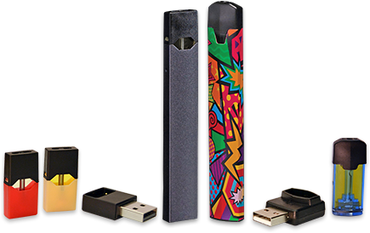
Vaping, or the use of e-cigarettes, involves using a device that heats a liquid into an AEROSOL that the user inhales.
The liquid usually has NICOTINE and flavoring in it, and other additives. Nicotine is extremely ADDICTIVE.
E-cigarettes are considered TOBACCO products because most of them contain nicotine, which comes from tobacco.
Vaping is ILLEGAL for anyone under the age of 21.
Notes:
Vaping, or the use of e-cigarettes, involves using a device that heats a liquid into an aerosol that the user inhales. The liquid usually has nicotine and flavoring in it, and other additives. The nicotine in e-cigarettes and regular cigarettes is addictive. E-cigarettes are considered tobacco products because most of them contain nicotine, which comes from tobacco. Vaping is illegal for anyone under the age of 21, after the passing of federal Tobacco 21 laws in December 2019.

Slide 4

Vaping history
The global emergence of vaping has occurred during YOUR LIFETIME.
This means your generation are the GUINEA PIGS!
We are still studying the effects of vaping--especially after long-term use.
Now that the popularity of traditional cigarettes has declined, many tobacco manufacturers have expanded to producing vape products--and they want YOU on board!
Notes:
While smoking and traditional cigarettes have been in existence for centuries, the global emergence of vaping and e-cigarettes has happened during your own lifetime. This means kids your age are the guinea pigs. Just as it took decades to really learn how smoking traditional cigarettes impacted the body, we’re just now able to start studying the negative effects of vaping, especially after long-term use. Many manufacturers of traditional cigarettes are now producing e-cigarettes, and they’re using the same marketing tactics to lure in young people so they will have lifetime customers—just as they did with traditional cigarettes.

Slide 5
Vaping & the four circles of self-care
Notes:
Vaping and the use of nicotine negatively impacts your health in more ways than you might imagine. You may have heard of the four circles of self-care.

Slide 6
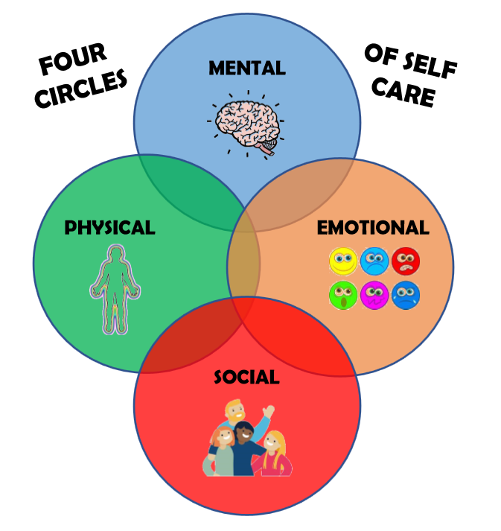
Notes:
Self-care includes all the things you do to take care of your well-being in four key dimensions –mental, physical, and emotional health, as well as your social connections. In contrast, negative practices and behaviors, such as abusing a substance, can harm each of those aspects of your wellbeing. Let’s look at how vaping impacts the four circles of self-care.

Slide 7

mental
Nicotine changes the way synapses are formed.
This impacts attention and learning.
Adolescent brains are still developing—at least until age 25.
Using nicotine “teaches” the brain that it needs that chemical to function.
Young people are MUCH more easily addicted than adults.
Addiction to nicotine primes the adolescent brain for addiction to other drugs--such as alcohol, cocaine, or heroin.
Notes:
Adolescent brains are not yet fully developed. Young brains are still in “learning mode” until at least age 25. Using nicotine teaches the brain that it needs that chemical to function. As a result, young people will become addicted to nicotine more easily than adults will. Nicotine also changes the way brain synapses are formed, which can negatively impact attention and learning. Addiction to nicotine also primes the adolescent brain for addiction to other drugs, such as alcohol, or even cocaine or heroin.

Slide 8
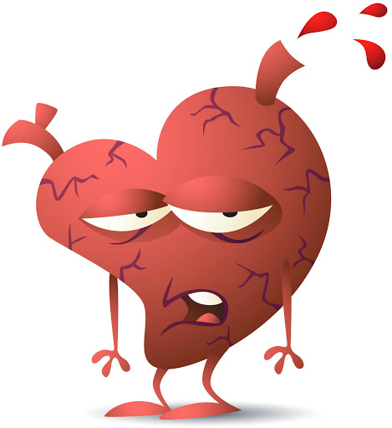
physical
Cardiovascular:
Increased heart rate and blood pressure
Increased risk of heart attack or stroke
COUGHING
WHEEZING
HEADACHES
SEIZURES
VOMITING
Respiratory:
Decreased lung functioning
Greater incidence of inflammation, asthma and wheezing
CHEMICALS IN VAPE ARE TOXIC AND CAUSE CANCER
Notes:
Immediate effects of vaping may include coughing and wheezing, headaches, seizures, or vomiting. Nicotine negatively affects the cardiovascular system, increasing heart rate and blood pressure and the risk of heart attack and stroke. It also impacts respiratory and lung functioning, causing greater incidence of inflammation, asthma and wheezing.
The other ingredients in vape products, including the flavorings, are harmful as well. Most contain cancer-causing and other toxic chemicals, heavy metals and tiny particles that go deep into the lungs and cause lung damage, cell damage and reduced ability to fight off infections.

Slide 9

Emotional
THE TRUTH:
Nicotine use (especially once addicted)
brings on
ANXIETY
MOOD SWINGS
IRRITABILITY
MYTH ALERT!
Nicotine helps people calm their nerves and anxiety
Notes:
It’s a long-held myth that using nicotine can help people calm their nerves and anxiety. But the truth is, nicotine can cause anxiety symptoms, or make them worse. Nicotine can cause mood changes and irritability, especially once a person is addicted and attempts to stop using.

Slide 10

social
ADDICTION BRINGS ON A CHANGE OF PRIORITIES
Then: Be a good friend, son, daughter
Now: Find and use drug!
Changing Attitudes & Behaviors
Increased Risk Taking
Addiction can lead to a downward spiral that destroys a person’s school, work, family or social life
Notes:
Nicotine, and the addiction that follows, can be extremely disruptive to a person’s home and social life. The brain can become so preoccupied with getting its next fix of nicotine that it can impact the person’s ability to relate well to others. Accessing and using the drug becomes more important than being a good friend, son or daughter. In addition, attitudes and behaviors may change as a result of the substance use. Nicotine can lower impulse control and cause a person to take risks they wouldn’t normally take. Friends and family may try to reach out and help, but often the substance user doesn’t see how their behavior is impacting others. Addiction can lead to a downward spiral that destroys a person’s school, work, family or social life.

Slide 11
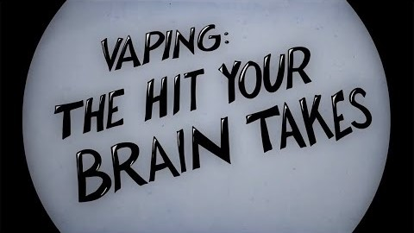
Video: Vaping is more harmful than you think

Slide 12

Be your best self!
Make positive choices every day
Notes:
To be your BEST SELF, avoid nicotine, alcohol and other drugs. Nourish yourself mentally, physically, emotionally, socially and spiritually. Make good choices daily and adopt positive habits.

Slide 13


Get help if you need it!
DAKOTA STUDENT ASSISTANCE CENTER
Ninth Grade Center Room 357:
Mrs. Black, lblack2@cvs.k12.mi.us or (586) 723-3331
Main Building Room 249:
Mrs. Lange, slange@cvs.k12.mi.us or (586) 723-2872
NICOTINE QUIT LINE FOR ADOLESCENTS
Text “Start My Quit”
to (855) 891-9989
or visit https://mylifemyquit.com

Slide 14

assignment
WRITE A BRIEF RESPONSE TO THE FOLLOWING SCENARIO:
A friend approaches you on Monday morning and tells you about a party she went to over the weekend. She tried vaping for the first time. She wasn’t sure how much she enjoyed it, but she did like the fact that it made her feel cool in front of the other kids. She knows her older brother does it and is thinking of asking him to help her get one. Describe how you would convince your friend that this is NOT a good idea. Be sure to include at least one point from each of the four circles of self-care (mental, physical, emotional and social).

