Slide 1

How to achieve success during difficult times
From your Dakota High School Guidance Counselors

Slide 2
Q and A with your counselor …
What questions to you have that you’ve been wanting to ask but didn’t know how?
If you were in school, you might sign up to see us – you still can. Use Teams to contact us.

Slide 3
Helpful reminders
Use the Guidance Department website – transcripts, work permits, scholarships, NCAA, social/emotional support, etc.
Parchment account for transcripts – Juniors and Seniors
Twitter – follow us for up-to-date important information:
  Dakota HS 10-12 Counselors @hs_dakota
(PS - We’re not on Schoology yet, so don’t send us messages in there because we will not get them. Use Teams. We’d love to hear from you and help you identify your own “tool kit” of strategies.)

Slide 4
General tips to better academic and emotional health:
Academics and emotions impact each other.
Mindset – when you can’t change the situation, change your attitude and approach to it.
Motivation – Ask yourself if your choices are getting you closer to your goals? If not, maybe it’s time to make some changes.
The importance of routine and structure, especially in chaotic times.
Connection – eye contact with others; the 5 senses helps you reconnect.
Are you using the resources you have been provided – a lot of people forget to tap into those and struggle to figure things out on their own.

Slide 5

Struggling academically?
You may not like remote learning, but it’s what we have for now, so we need to find ways to make the best with what we have.
Stop negative self talk, like telling yourself you can’t do this.
Organize or structure your time - create a schedule w/ specific times for homework, breaks, & social time, self care, and sleep.
Stay mentally engaged – take notes; ask questions
Engage with other students - set up face-time study groups after school
Use academic support resources - Khan Academy, K12Connect with GVSU, Wolverine Tutoring, etc.

Slide 6



Are you procrastinating?
Identifying why can help you overcome it.
    You’re not sure you will be able to solve the homework problems?
      OK – what resources are available to help me?
    You’re not interested in the subject?
      OK – but is procrastinating getting me closer to my goals?
    You’re physically or mentally tired?
      OK – maybe I need to change my daily routine, so I am more alert for classes.
    You’re just being lazy?
      OK – there is no real reason I can’t do this, so I might as well just get it done.

Slide 7
Overcoming an academic slump and / or Procrastination
Once you figure out why you’re procrastinating, you can use different tips to help you overcome it. Find the ones that work for you:
  Eliminate distractions – cell phone, tv, puppy, etc.
  Get enough sleep – the brain can’t concentrate if it’s tired.
  Focus on progress rather than perfection.
  Break large tasks into smaller steps – ask for help if needed.
  Finish one task before starting another.
  Use a timeline, chart, agenda, or calendar to get organized.
  Change your environment / scenery – homework in a different area.
  Identify rewards for following through with your responsibilities.
  Organize your workspace and declutter it weekly to stay organized.
  Daily or subject folders to help with organization.
  If a task takes less than 5 minutes, do it now.
  Chunk studying into a few shorter periods rather than a long one.
  Keep messy foods and drinks away from your workspace.
  Daily schedule – set time for work as well as breaks.

Slide 8
Struggling emotionally?
There are simple strategies you can do to help cope with stress, anxiety, or depression:
Go for a walk – maybe a sensory walk
Talk to a friend – facetime so you can have eye contact to feel more connected.
Practice deep breathing - in to the count of 4, hold, out to the count of 4
Play a mental game – my color of the day is yellow; memory game, match-up game, etc.
Do a “brain dump” – get your thoughts out onto paper so they stop clouding your mind.
Challenge negative thinking
Create a “happy place” you can visit when you need to escape
Meditation

Slide 9
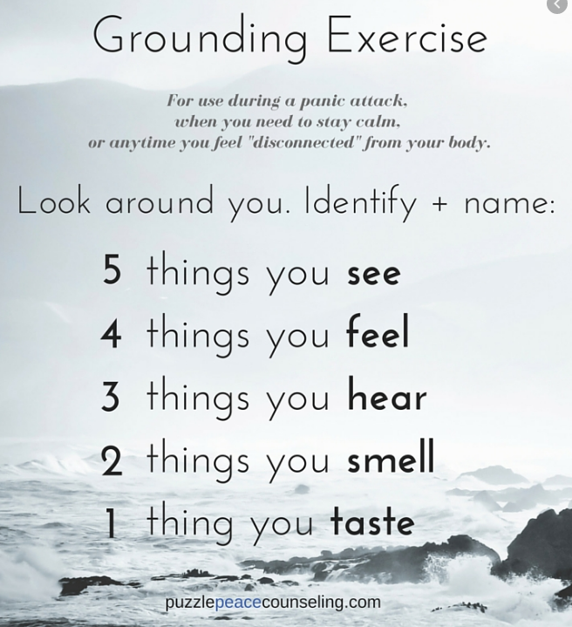
Positive v. Negative filters – how we choose to view a situation impacts our mood, our success, our productivity. Choose positive.
Mindfulness – being aware of ourselves in the moment. Paying attention to our surroundings and/or our emotions.
Breathing exercises
5 senses – Grounding exercise

Slide 10
COPING STRATEGIES
Deep breathing
Take a mindful walk
Yoga, stretching, dancing, exercise – maybe virtually w/ a friend Remember or sing the words to a song you love
Positive self talk
Crossword / sudoku puzzles; play a card game w/ a friend
Bake / cook something – with family can make it more fun.
Read, draw, color, doodle
Write a story, song or poem
Journal – try a GRATITUDE journal or a CALMING jar
Learn a new hobby
Tense/release muscles in the body; fidget toy, stress ball.
Do something KIND for someone – instant mood booster!
Choreograph weekly tik tok dance, write thank you letters to soldiers, help a younger sibling with something, etc.
Take a virtual trip to somewhere around the world – visit the Smithsonian, a zoo, a museum, a natural wonder, etc. Go on this “trip” with family or a friend.
Feeling disconnected?
Strong coping skills help us to be resilient and survive difficult situations.
Choose some of these strategies to help you overcome tough times.

Slide 11
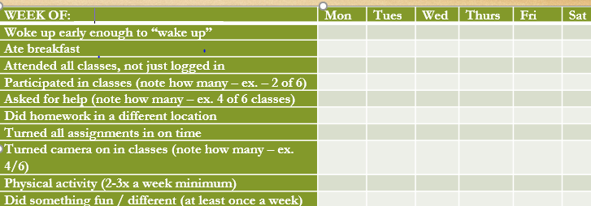
Accountability
Chart
Identify self-care strategies that help you the most academically and emotionally – then build them into a chart.
On school days, get out of bed early enough to wash your face, eat breakfast, and brush your teeth.
Do not lay on your bed - Your mind associates it with sleep, so it’s harder to be alert when on your bed.
Stay logged in after the teacher releases you and do your work, so if you get stuck, you can ask for instant help.
Do your homework in a virtual group w/ classmates so you can help each other.
Get outdoors – your brain and body need fresh air.
Change your scenery –go outside for a few minutes on break, do homework in a different spot.
Do something fun / unique at least once a week.

Slide 12


