Slide 1
Dual Enrollment Presentation for 23-24

Slide 2
Benefits of Dual Enrollment
This opportunity is for students who have demonstrated a strong academic performance in high school and are prepared to do college work. Other benefits include:
• Students have access to courses not currently offered by the high school
• Dual enrollment students may count their earned college credits both toward high school graduation and college requirements
• A head start on a college career by taking classes before students graduate from high school
• Financial savings. The tuition at Macomb Community College (MCC) is substantially less than the cost of most state universities.

Slide 3
Things to Consider When Deciding on Dual Enrollment
Students should have a history of academic success and their measurable skills should be appropriate for college level rigor and expectations.

Slide 4
Things to Consider When Deciding on Dual Enrollment
Students should be emotionally mature; they are attending classes with students over the age of 18.

Slide 5
Things to Consider When Deciding on Dual Enrollment
Consider the rigor of the student’s high school classes (AP and/or Honors) taken at the same time as the college class, as we don’t want students to feel overwhelmed with their course load.

Slide 6
Things to Consider When Deciding on Dual Enrollment
If a student does not successfully pass the dual enrollment course, the student will be charged for all fees and costs that the district incurred for the course. This includes courses that are dropped after the appropriate time limits set by the college for full tuition reimbursement.

Slide 7
More Things to Consider When Deciding on Dual Enrollment
If a student drops a course, they will need to immediately inform their high school counselor and enroll in additional high school classes. Not doing so could have an impact on graduation.
Credit for courses cannot be changed after class has started. The choices are College only, High School only or College & High School credit. Credit goes on your permanent school records. A counselor can answer any questions about this if you are unsure.

Slide 8
More Things to Consider When Deciding on Dual Enrollment
Transportation is the responsibility of the parent/guardian and student. For safety and supervision reasons, students must leave the building after their scheduled Dakota classes.
Athletics, Band and Choir require after school and evening participation which may conflict with the student’s MCC class schedule.
College courses chosen must begin AFTER the student’s high school schedule ends (travel time must also be accounted for).

Slide 9
Books
The approximate cost for books is $40.00 - $150.00 per class. After you have enrolled in your class(es), check with the instructor/institution before purchasing books. If money remains after the fees, the district will apply it to the cost of required textbooks only. Students will be responsible for paying part or all their textbook costs once the full foundation allowance has been applied. The school will charge this difference to the DHS student account, which can be reviewed on Pay Schools Central. You can access Pay Schools Central through the Dakota High School website.

Slide 10
Possible Sequence for Dual Enrollment

Slide 11
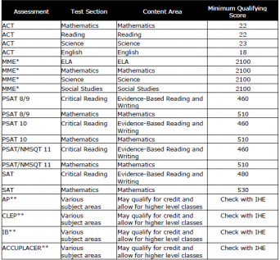
Preparing to Dual Enroll
Students will need to make sure that they have qualifying test scores.

Slide 12
Dual Enrollment Preparation cont.
Update your Xello student account. If you are enrolling in a course that is part of a sequence of courses that we offer (ie. Foreign Language, etc.), you must have maxed out of the highest level at Dakota to enroll in the class. The class you are interested in cannot be offered in the CVS Course Catalog.
Schedule an appointment to meet with your counselor. Discuss course options that are right for you and fit your school schedule and other commitments. IE: athletics, band, choir commitments. Macomb class requirements will take precedence over after school activities, so consider carefully.

Slide 13
Dual Enrollment Preparation cont.
Ensure your course of interest does not have prerequisites and is a full semester 3 or 4 credit hour course (this info is available through course options and prerequisite course information on the MCC website).
Return completed Dual Enrollment Request Form to your counselor by the specified deadlines. Deadlines are set to ensure the Counseling office has the time necessary to ensure all registration materials are transferred to MCC by their deadline.
Dual Enrollment Request Forms are due by April 1st each school year.
Complete Macomb Community College enrollment steps.

Slide 14
Dual Enrollment Sponsorship Form
SPONSORSHIP – Since you will be a sponsored student (High School or State sponsored), Dakota will submit the Dual Enrollment Sponsorship Form by the payment due date for the semester. Students will receive an email once the sponsorship form has been received and processed. However, you must first complete and turn in your Dual Enrollment Request Form (on Dakota’s website) before we will complete the Sponsorship Form. Students must complete a form for each semester of Dual Enrollment.
If a student is self-paid, no form is required

Slide 15
Dual Enrollment at Macomb Community College Michael R. Baysdell, Director of K-12 Relations

Slide 16
My background
Dual enrollment is a MISSION for me.
I was one of the first Dual Enrollment students after the 1996 “Dual Enrollment” bills passed the Michigan legislature. Earned 19 credits my Senior year.
I used these credits I earned to slice a full year off my Bachelor’s Degree at Alma College.
Earned my Masters in Arts in Education and Teaching Certification through the University of Michigan.
I was teaching at age 22 with my Master’s Degree.
Dual Enrollment can do the same for you!

Slide 17
Dual Enrollment
Dual Enrollment is open to both public and non-public high school students.
If a student attends a public high school, that school funds the course(s) through a formula determined by the State. If a student attends a non-public school, the State of Michigan provides the funding by a similar formula.
In either situation, Macomb Community College is authorized by a sponsorship agreement to charge for tuition, fees, and, depending on the school, possibly books.
Students are responsible for any costs above the sponsored amount, and they can be sponsored for 10 courses throughout grades 9-12.
Eligibility is determined by the sponsoring school or district.

Slide 18
Dual Enrollment cont.
Students MAY also self-pay for summer courses or courses exceeding the 10-course limit.
Courses NOT allowed: Religion, Physical Education, hobby/craft courses
Parents: All other courses are open to your student—choose carefully!
There are ramifications financially if you fail a class—you may need to reimburse your district
Keep in mind—you are starting a college transcript and those grades travel with you from now on!

Slide 19
Process for Applying and Enrolling at Macomb Community College
Your counselor completes a Dual Enrollment Sponsorship Form that specifies which classes may be taken.
Create admission account.
You apply to Macomb Community College and get admitted as a DUAL ENROLLMENT student—you’ll need SSN to do so
Once admitted, we’ll email with next steps:
Complete New Student Orientation, Starting at Macomb, and Placement.

Slide 20
Applying and Enrolling cont.
It takes about 4 hours to get your MyMacomb password.
You need to complete Multi-Factor Authorization (MFA)
After these steps are completed, enrollment will be possible—you are responsible for registering for classes.
After you’re signed up—you MUST use/check your new Macomb CC e-mail account regularly.

Slide 21
Questions?
baysdellm511@macomb.edu
Make me your first point of contact for all issues involving K-12 Relations!
(586) 349-8707

Slide 22
Next Steps for Dakota
Once you have completed the Macomb Admissions steps, go to Dakota’s website and read through the dual enrollment documents under the counseling tab→dual enrollment.
Go to Macomb’s website (Macomb.edu) and select “Future Students”→then List of Programs.
Select your subject of interest and scroll down to choose from the classes listed.
Write down the names of courses that interest you on a sheet of paper.
Select the link “Class Offerings & Catalogs” link to your left.
Select “Search for Sections Now”

Slide 23
Next Steps for Dakota cont.
7. Click in the “Search for courses” box at the top right of the page. Type in the name of the course you want.
8. Select “View Available Sections” to see the dates and times that each course is offered. Write down the course numbers of the classes you selected.
9. Once you have identified 2-4 classes (this includes your alternates) you would like to take, go back to the dual enrollment page on Dakota’s website and select the fillable “Dual Enrollment Request Form” to enter your classes.
10. Complete the entire form before printing. Request a meeting with your counselor to go over your selected classes and to turn in your Dual Enrollment Request Form.

Slide 24
There are resources available for you as Macomb Community College Students

Slide 25
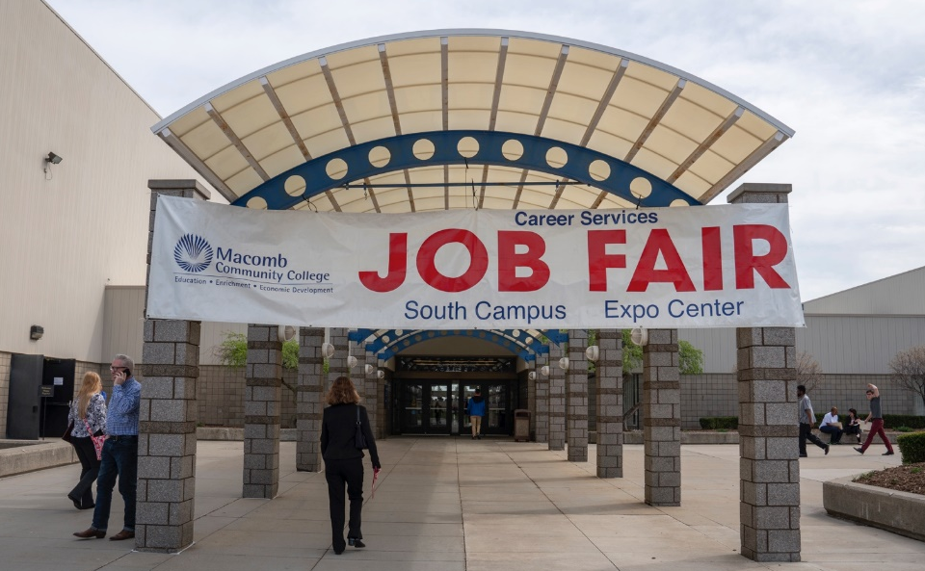
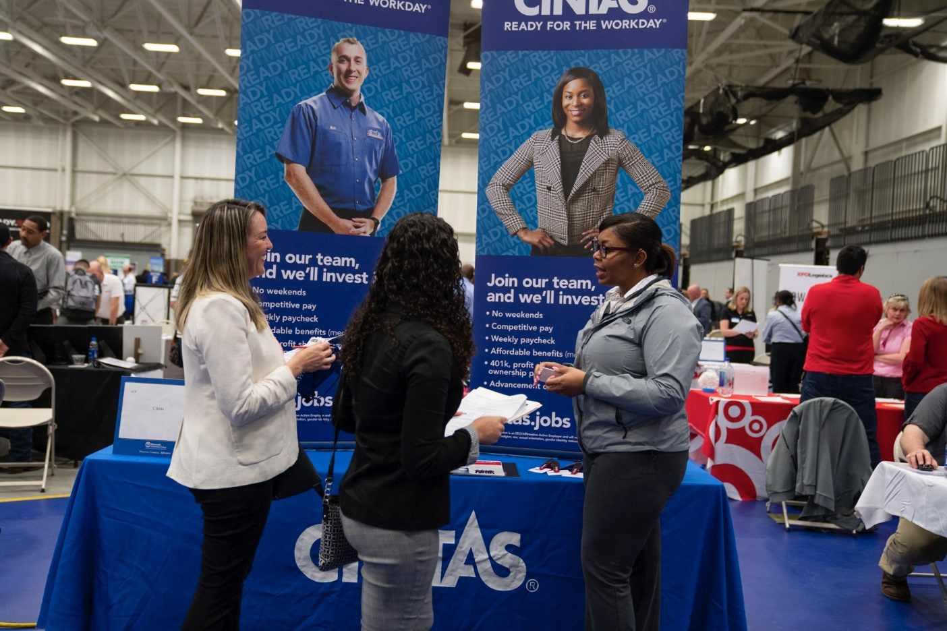
Resources & Support
• Career Services
• Learning Centers
• Reading & Writing Studios

Slide 26
Thank you!
If you have questions, please be sure to reach out to your counselor.
Mr. Anderson: A-Dam
Mrs. Gay: Dan-Ir
Mrs. Ede: Is-Mos
Ms. Simmons: Mot-Sel
Mrs. Carr: Sem-Z

