Slide 1
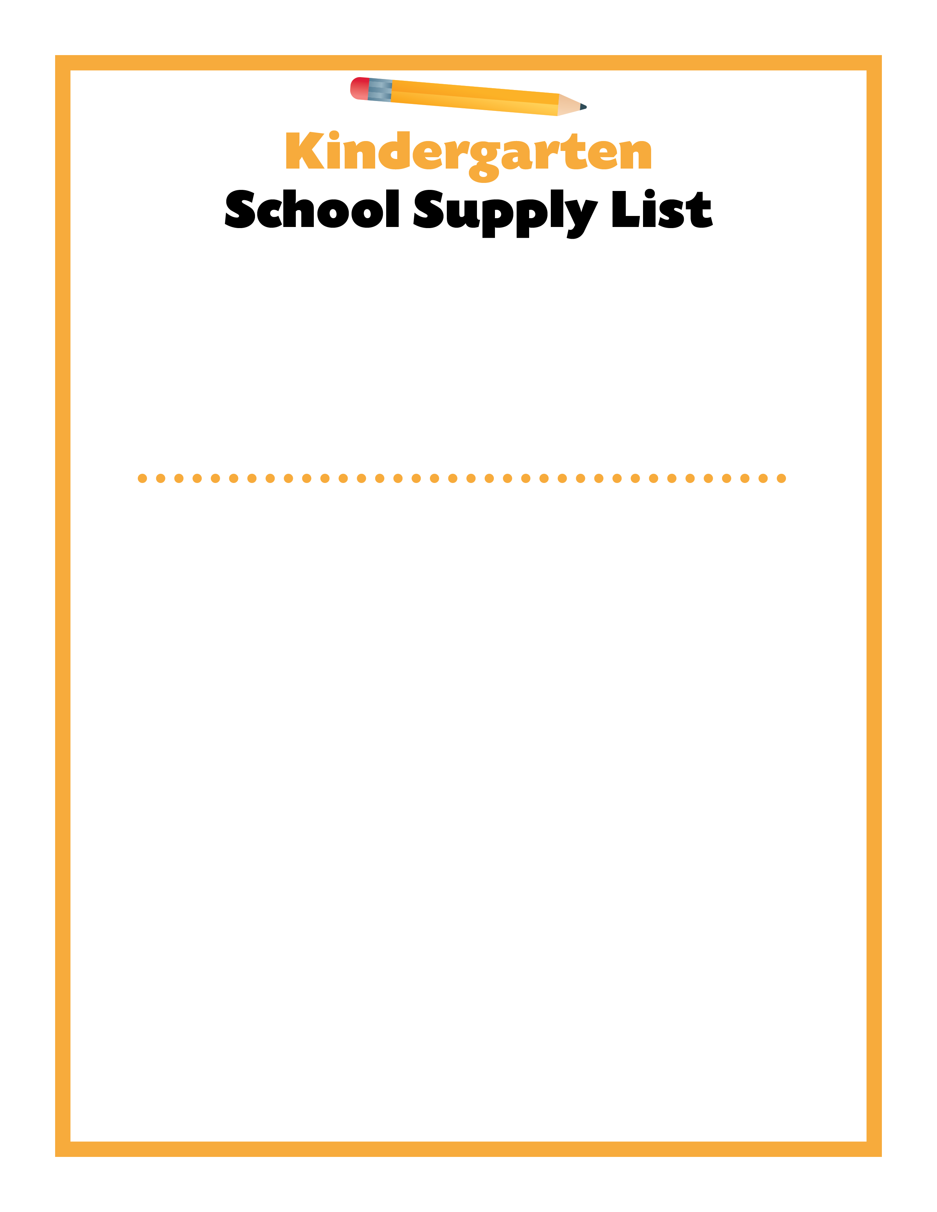
Dear Kindergarten Families,
I am so excited to be your child’s teacher for the 2022-23 school year. Please make sure your child has the following school supplies ready for the first day of school. I look forward to meeting your child and giving them the best ever start to school!
Sincerely,
Kindergarten Teachers
Backpack
Lunchbox
Reusable water bottle
Pencil box
Two boxes of 12 sharpened No. 2 pencils
Personal pencil sharpener
One large pink eraser
Two boxes of 24 crayons
One box of 8 washable markers
Individual white board
One box of 4 dry erase markers
One pair of blunt-tip scissors
One bottle of white school glue
Six glue sticks
Two primary composition notebooks
Two two-pocket folders
Two boxes of tissue
One roll of paper towels
One container of baby wipes
One container of Lysol® Disinfecting Wipes
One box of plastic storage bags: gallon, quart, or sandwich
One pair of headphones
Extra set of clothes sealed in a gallon bag

Slide 2
Dear Kindergarten and 1st Grade CLP Families,
I am so excited to be your child’s teacher for the 2022-23 school year. Please make sure your child has the following school supplies ready for the first day of school. I look forward to meeting your child and giving them the best ever start to school!
Sincerely,
Mrs. Bock
Backpack
Lunch bag
Reusable water bottle
Two boxes of Kleenex
One bottle of hand sanitizer
One bottle of hand soap
Three boxes of 24 crayons
Three containers of Play-Doh
Two boxes of Crayola Markers
Two boxes of #2 pencils
Three pack of erasers
Six Elmer’s glue sticks
One pair of scissors (loop or spring-loaded)
One 1 inch, 3 ring binder with view pocket in front
One packets of top loading sheet/paper protectors
Four containers of Disinfecting wipes (all scents)
Three bags of individually wrapped candy
Three pencil boxes to keep supplies in the desk
One change of clothes in case of an accident
Diapers/Pull-ups and wipes if needed
Donation $20.00 (cooking and Holiday craft projects)

Slide 3
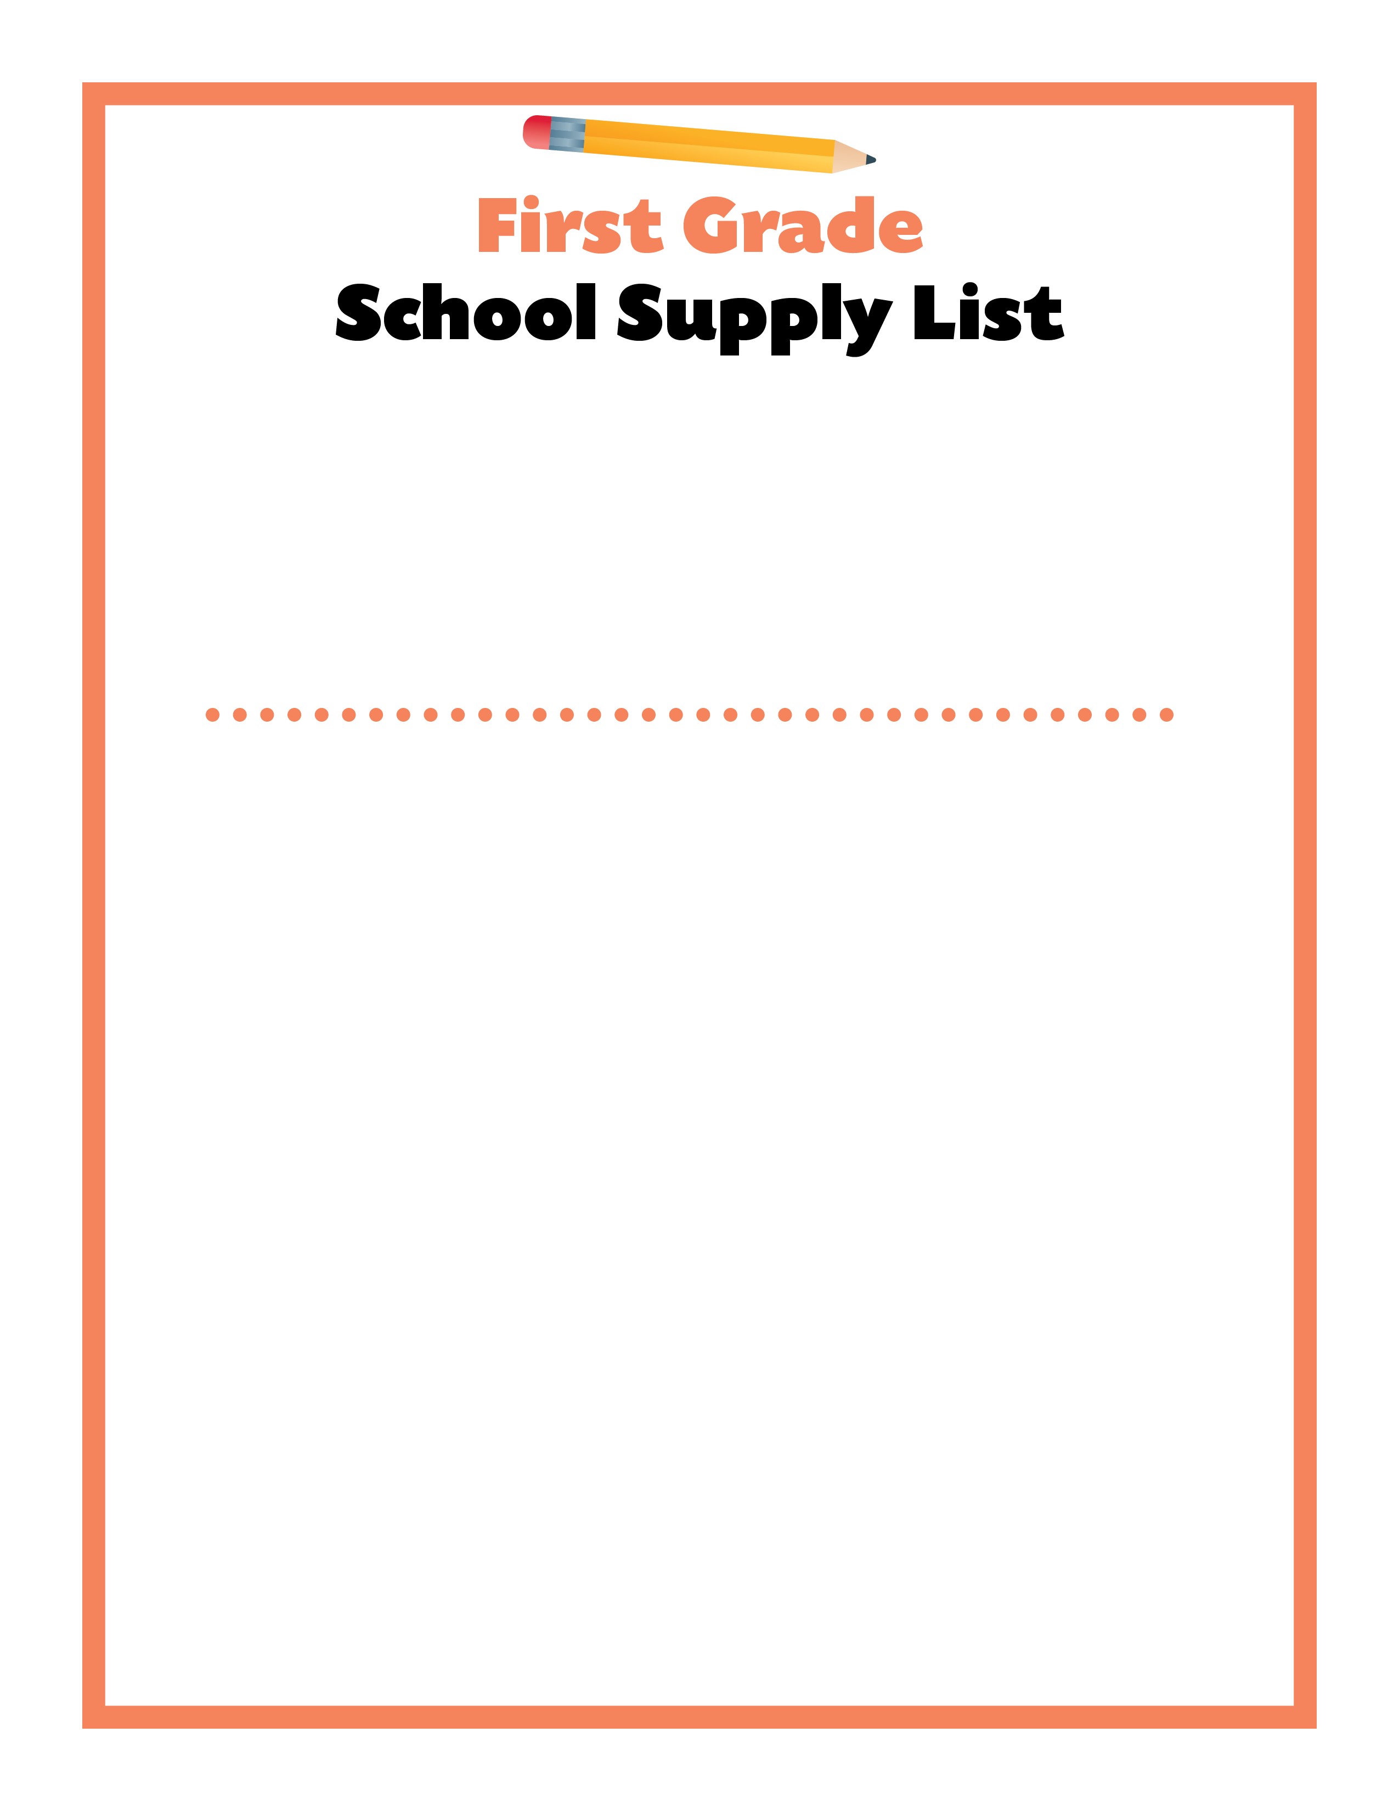
Dear First Grade Families,
I am so excited to be your child’s teacher for the 2022-23 school year. Please make sure your child has the following school supplies ready for the first day of school. I look forward to meeting your child and giving them the best ever start to school!
Sincerely,
1st Grade Teachers
Backpack
1 light brown pillowcase (Please write name inside on the label)
Standard size pencil box – NO POUCHES
Four boxes of 24 crayons
20-24 sharpened No. 2 pencils
One large pink eraser
Colored Pencils (the kind with erasers work well)
One box of markers
3-4 dry fine tip erase markers
2 yellow highlighters
One pair of kid size Fiskars scissors
12 glue sticks
1” Binder Clear-View
50 clear sheet protectors already loaded into the 1” clear view binder
2 pocket folders (any color) – no prongs
1 pair of headphones
One boxes of Kleenex
One box of baby wipes
Boys: 1 box of Gallon size Ziploc bags
Girls: 1 box Quart size Ziploc bags

Slide 4
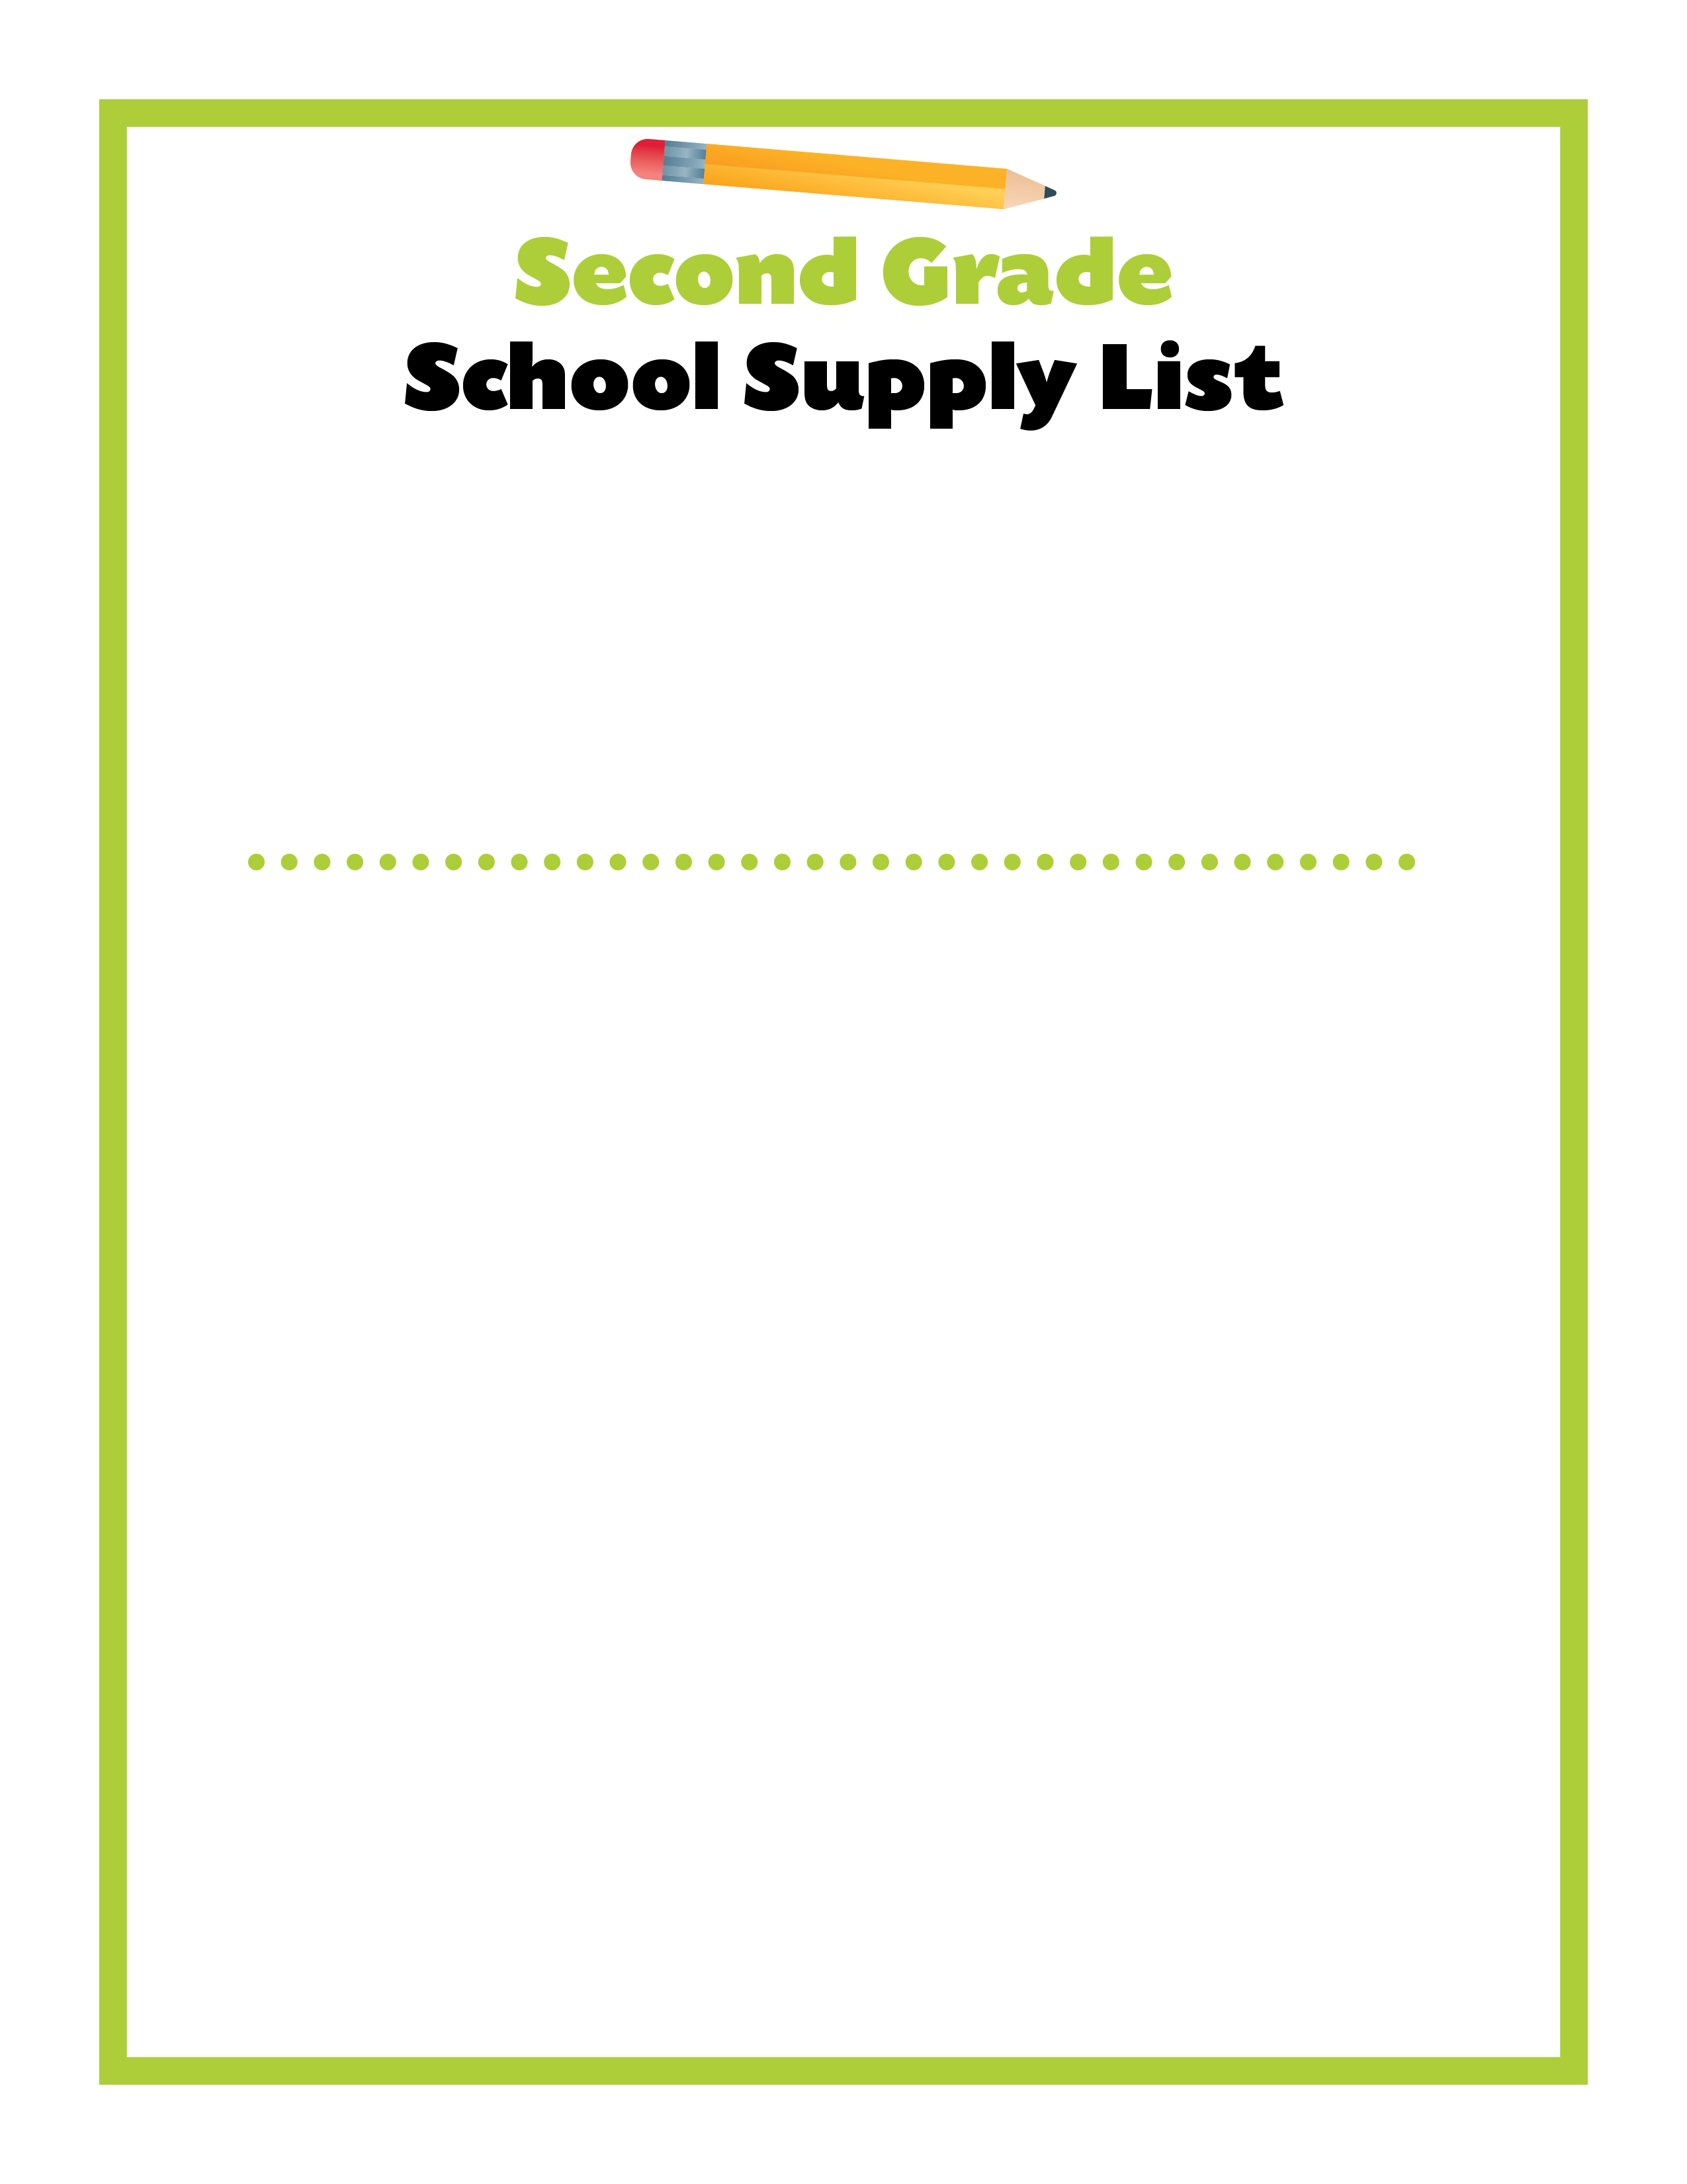
Dear Second Grade Families,
I am so excited to be your child’s teacher for the 2022-23 school year. Please make sure your child has the following school supplies ready for the first day of school. I look forward to meeting your child and giving them the best ever start to school!
Sincerely,
2nd Grade Teachers
Reusable water bottle
Small pencil box
Sharpened pencils
Erasers
Crayons (24 or fewer)
Colored Pencils
Yellow Highlighter
2 any color dry erase markers
Scissors
One bottle of white school glue
2 large or 4 small glue sticks
Two wide-rule notebooks
Two plastic duo-tang folders with pockets and metal prongs to insert papers
1 three ring binder with child’s name on it
One box of Kleenex
Large hand sanitizer or refill bottle
One bottle of hand soap or refill bottle – kids love the fruity kind!
One container of baby wipes or refill pack
One container of Disinfecting Wipes
One box of plastic storage bags: gallon, quart, or sandwich
1 deck of playing cards for Math games
One pair of inexpensive headphones

Slide 5
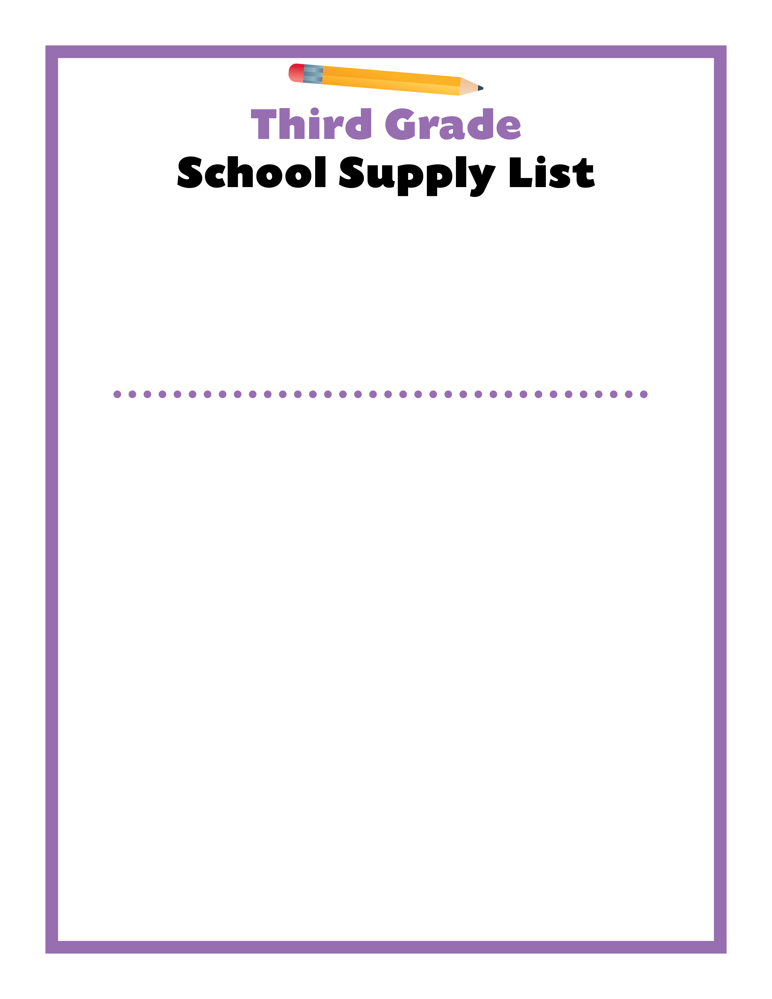
Dear Third Grade Families,
I am so excited to be your child’s teacher for the 2022-23 school year. Please make sure your child has the following school supplies ready for the first day of school. I look forward to meeting your child and giving them the best ever start to school!
Sincerely,
3rd Grade Teachers
Backpack
Lunchbox
Reusable water bottle
Pencil box
12 sharpened No. 2 pencils
One box of 24 crayons
One box of 24 colored pencils
Two highlighters
2 Red checking pens
One pair of scissors
One bottle of white school glue
Six glue sticks 9 will need more throughout the year)
Ruler in/cm
Two wide-ruled spiral-bound notebooks
One two-pocket folder (plastic)
Two boxes of tissue
One container of Lysol® Disinfecting Wipes
One pink eraser

Slide 6
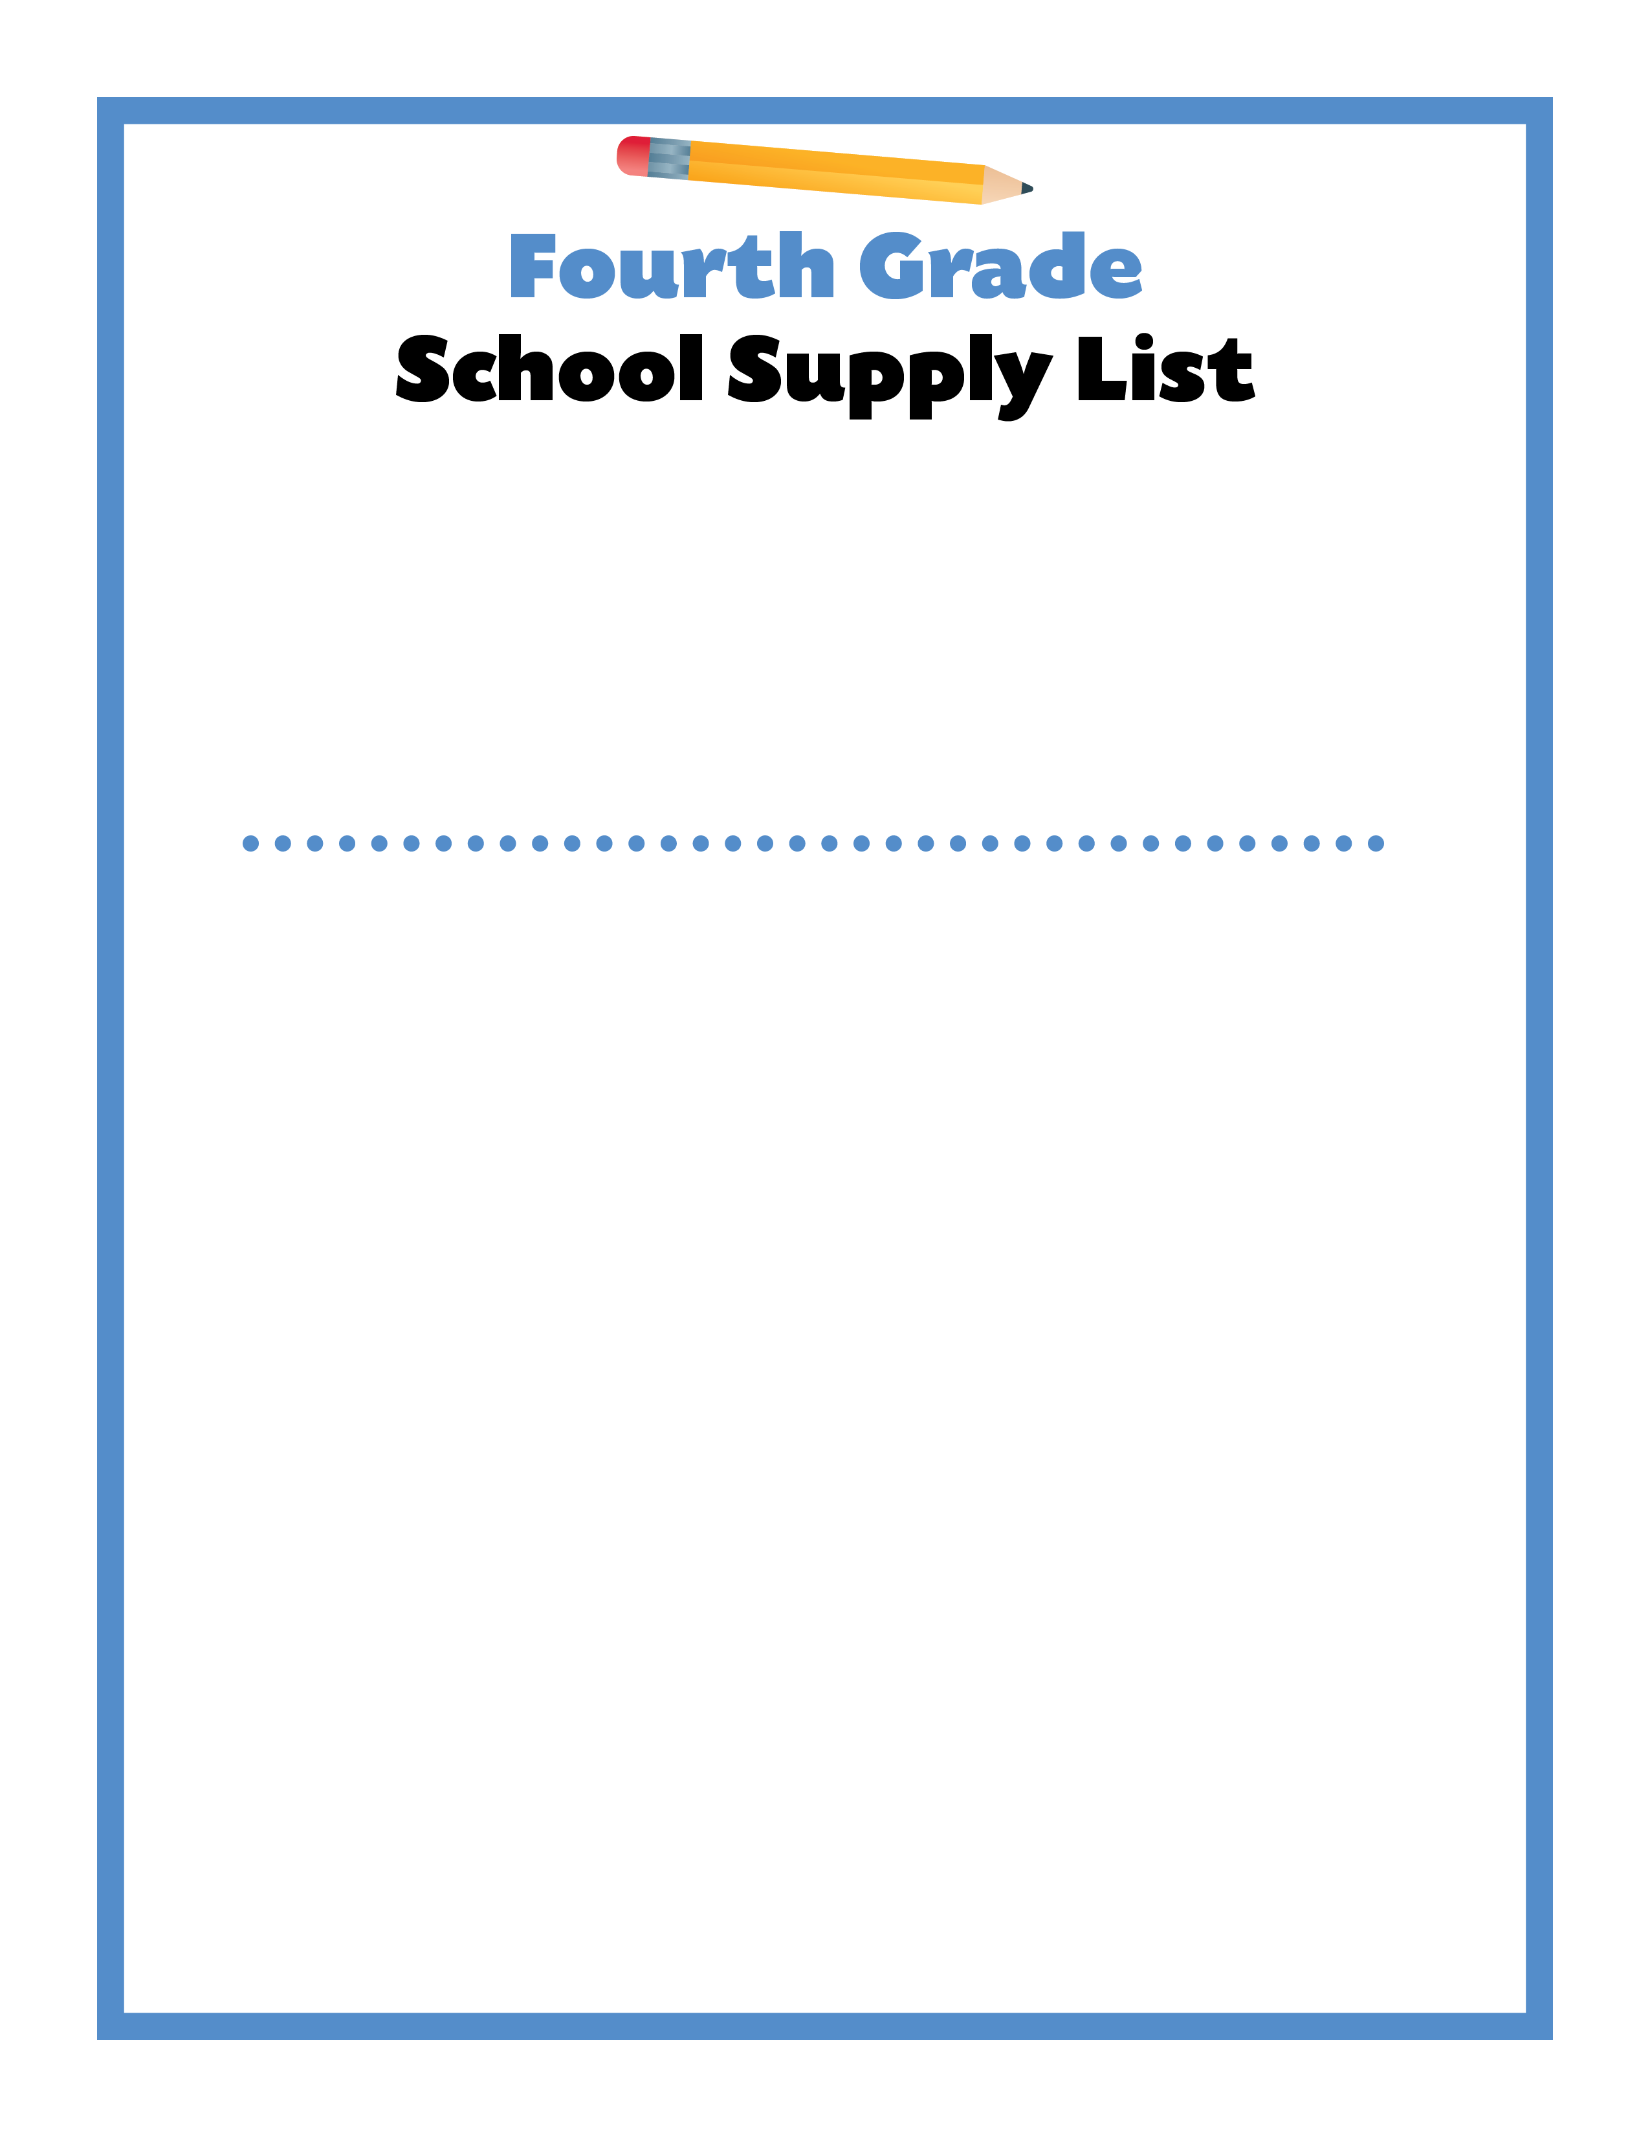
Dear Fourth Grade Families,
I am so excited to be your child’s teacher for the 2022-23 school year. Please make sure your child has the following school supplies ready for the first day of school. I look forward to meeting your child and giving them the best ever start to school!
Sincerely,
4th Grade Teachers
Reusable water bottle
Standard size pencil box
Two boxes of 12 sharpened No. 2 pencils
Two Chunky erasers
One box of 24 crayons
Two dry erase markers
Two highlighters
Two red pens
One pair of pointed-tip scissors
Two giant glue sticks
Ruler in/cm
Two two-pocket folders - preferably plastic (includes one for Music
Two boxes of tissue
One container of Lysol® Disinfecting Wipes
One bottle of hand sanitizer
One pair of headphones
OTHER ITEMS FOR TUTTLE:
Two wide-ruled spiral-bound notebooks
Zippered pencil pouch for manipulatives
Optional:
One Mouse
Colored Pencils
Markers
OTHER ITEMS FOR PRIDEAUX:
One 5-Subject Notebook
Markers

Slide 7
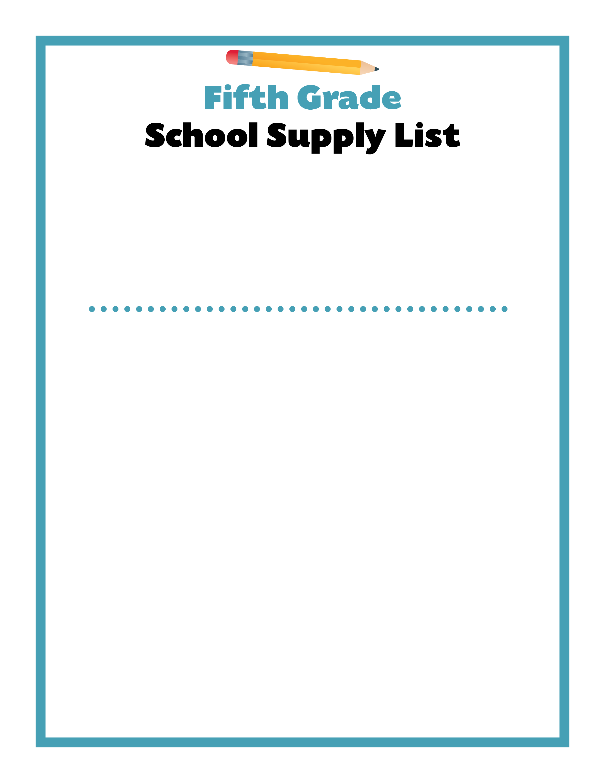
Dear Fifth Grade Families,
I am so excited to be your child’s teacher for the 2022-23 school year. Please make sure your child has the following school supplies ready for the first day of school. I look forward to meeting your child and giving them the best ever start to school!
Sincerely,
5th Grade Teachers
Backpack
Lunchbox
Reusable water bottle
One boxes of 12 sharpened No. 2 pencils – only 4-5 needed at a time
Personal pencil sharpener
Pencil top erasers
One box of 24 crayons
One box of 12 colored pencils
One box of 4 dry erase markers
Two highlighters
Two red pens
Two blue or black ballpoint pens
One pair of pointed-tip scissors
Six glue sticks
Ruler
Two wide-ruled spiral-bound notebooks
One packs of loose leaf, wide-ruled paper
One 1.5” three-ring binder
Accordion style organizer with at least 7 tabs labeled: READING, WRITING, SCIENCE, SS, CENTERS, TO BE CONTINUED, MATH 4 TODAY
Two roll of paper towels
Two or Three containers of Lysol® Disinfecting Wipes
One box of plastic storage bags: gallon, quart, or sandwich
Post-It notes – all sizes
One pair of headphones

