Slide 1


Kindergarten Kick-Off
May 24, 2019

Slide 2

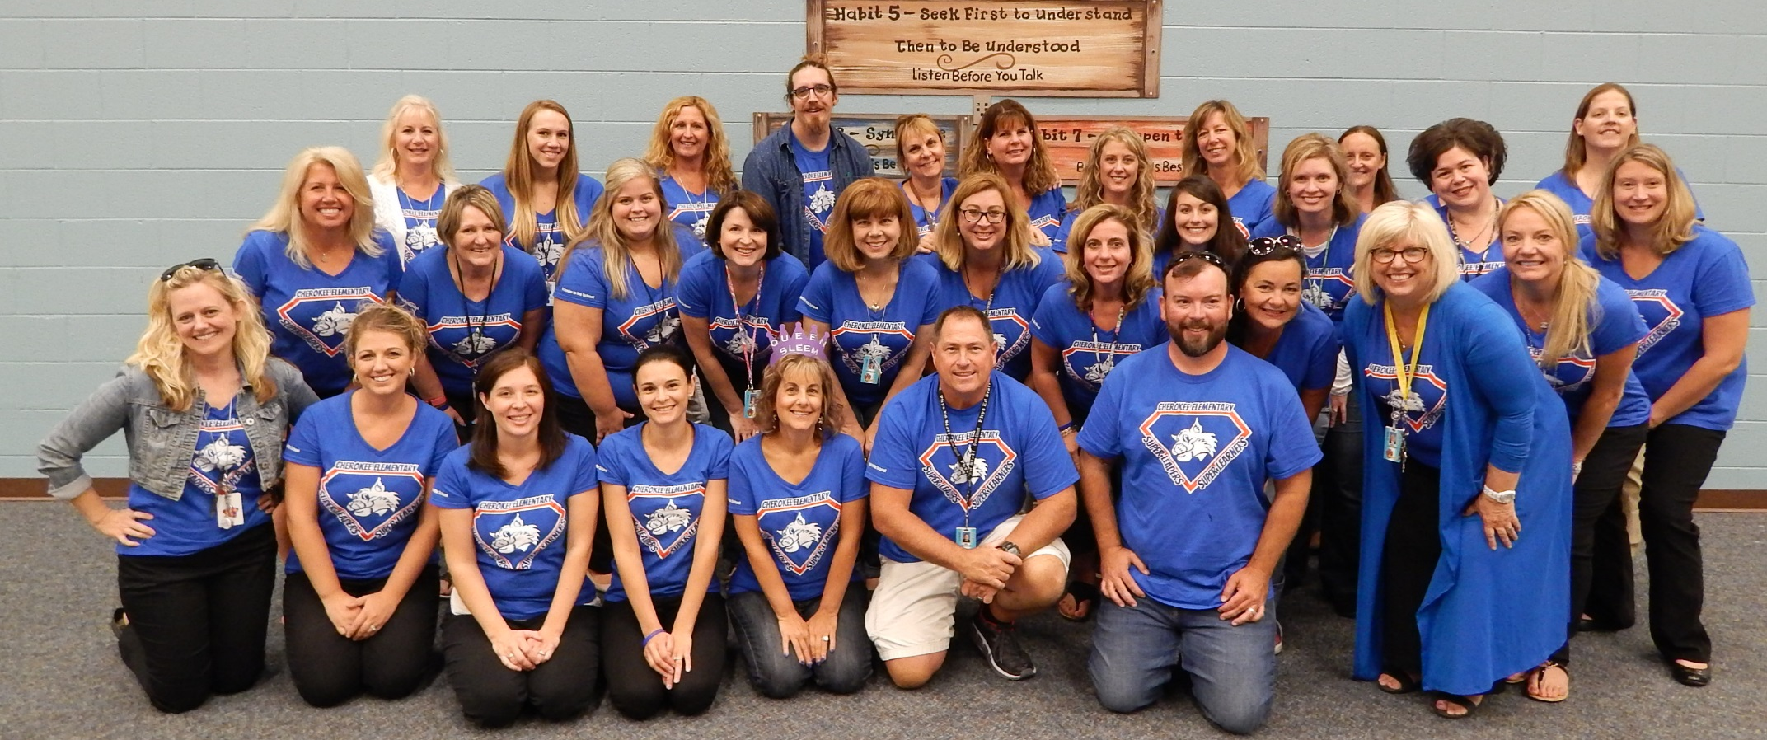
Welcome to Cherokee

Slide 3

The Office
Lynn Mair - Principal
Liz Tucci - Secretary
Kristy Garrett – Clerk
Karen Saraceno – Clerk
Shawn Rhodes – Health Aid
Main Number (586) 723-4800
Absence Number (586) 723-4899
Child Care (586) 723-4860
Our office is open from 7:45 am - 4:30 pm

Slide 4


Our Kindergarten &
Support Staff
Hollie Bracken
Emma Curcuru
Erik Roberts
Cheryl Sleem
Sharon Boguth
Chris Wargo
Gina Baggallay
Ashley Murphy

Slide 5



Slide 6
We believe …
~ every child has potential,
~ every child can be a leader, and
~ the relationships we foster play an important role in our students' success.

Slide 7


Student Success
Leading & Learning
We believe that success depends on 6 essential ingredients:
~ A warm, welcoming and safe environment;
~ A knowledgeable, caring and collaborative staff and community;
~ A rigorous, relevant and engaging curriculum that provides students with the skills and mindset necessary for success in the "real-world“;
~ Comprehensive, consistent, research-based instructional strategies;
~ A system that establishes, models and reinforces clear expectations and goal-setting;
~ A set of traditions that builds relationships, celebrates our diversity and empowers all of our community to become leaders.

Slide 8

Safety First
All entrances are secured throughout the school day
Identification is required for entrance at the main office
All visitors MUST report to the office
Students are released only to adults listed on Contact List
Arrival & Dismissal / Parking Lot / Bus
  Kindergarten children are only released to an adult, never on their own
Allergy Action Plan – See Mrs. Rhodes

Slide 9
The Curriculum
Based on the Expectations of the Michigan State Standards
  Math
  Language Arts
  Science
  Social Studies
Visit our website for more detailed information regarding curriculum and links to resources
families can utilize at home.
Join us for Welcome Back Wildcats
& Curriculum Night
Monday, August 26th

Slide 10

What to Expect in Kindergarten
Focus on leading and learning.
Participation in recess, lunch, snack & play each day.
Daily nap time is not scheduled; however,
students are provided with 15 minutes of
quiet time each afternoon.
Opportunities to volunteer and become involved.

Slide 11
What to Expect in Kindergarten
Tonight’s Rotations:
The Leader in Me & Social Skills with Mr. Roberts (Rm 7)
Literacy & Math with Ms. Bracken & Ms. Curcuru (Rm 6)
Getting Ready for Kindergarten with Ms. Sleem & Ms. Honore (Rm 8)
Staying Informed with Ms. Mair (Computer Lab)
These Rotations reflect Cherokee’s
School Improvement Goals & Focus.

Slide 12
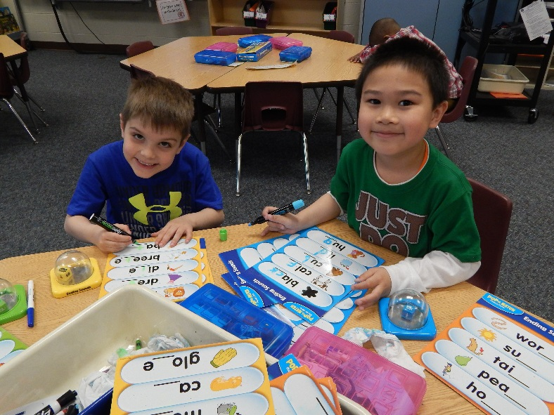
A Day in the Life of a Kindergartener
The following is an overview of the “typical” day …
Arrival & Morning Meeting
SMART Board Interactive Activities
Literacy Block - Journeys
Wildcat Workshop – Individualized Small-Group Instruction (Math/ELA)
Lunch/Recess/Quiet Time
Computer Lab/Library
Math Block ~ Bridges
Science/Social Studies Instruction
Specials (Science/Gym/Art/Music)
Center Time/ Free Play/ Outdoor Time
Closing Activities & Dismissal

Slide 13
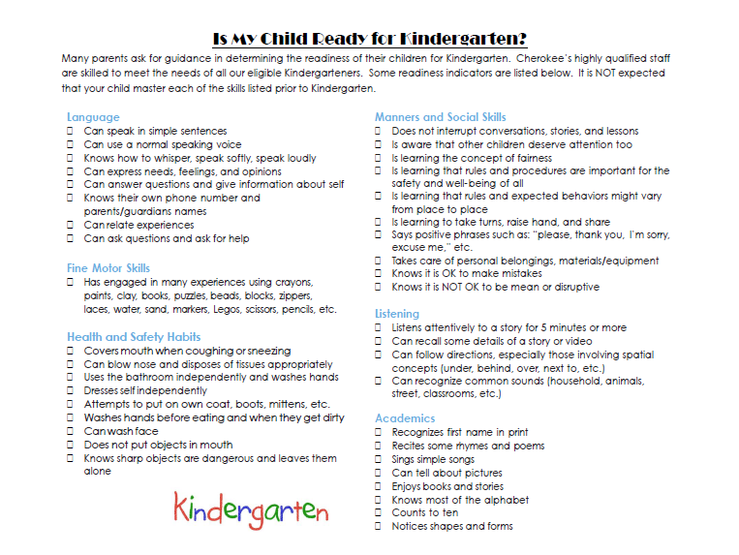
~ Preparing for Kindergarten ~

Slide 14











How to Get Involved
~ Your PTO Welcomes YOU! ~
Search: Cherokee Parents
Email: 35pto@cvs.k12.mi.us

Slide 15
How to Stay in Contact
School Messenger (mail-out system - phone calls and emails sent to Primary Contact Info)
Cherokee Website
Chippewa Valley Schools Website
Cherokee Facebook Page

Slide 16



June 5th
May 17th

Slide 17

Thank you for joining us this evening ~ Together, we make Cherokee a
GREAT place to be!

