Slide 1
Consumer Driven Accounts (CDA)
Benefit Account Enrollment
BASIC | www.basiconline.com

Slide 2
BASIC CDA
Features

Slide 3
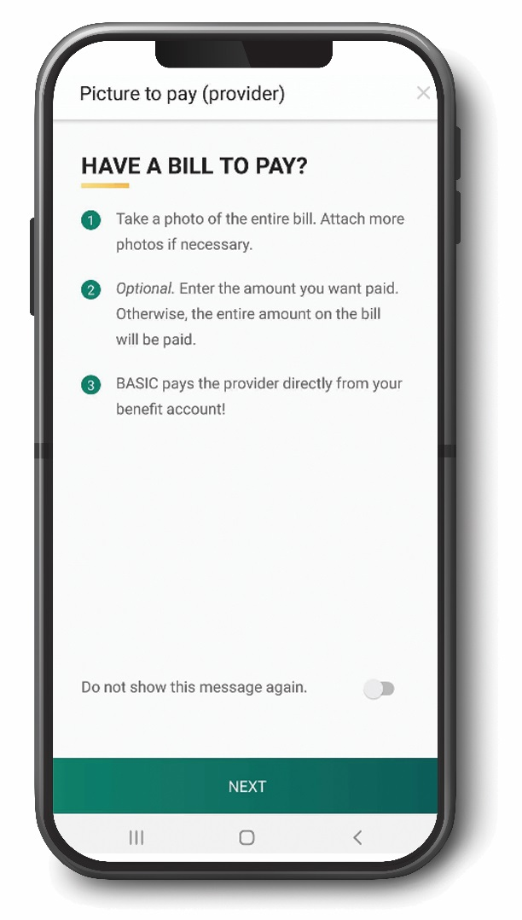
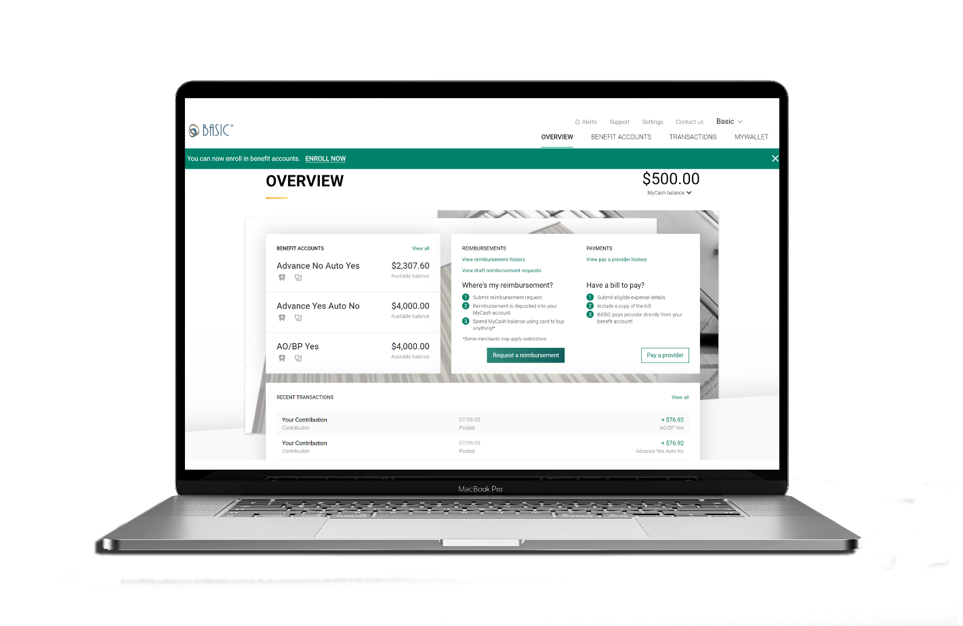
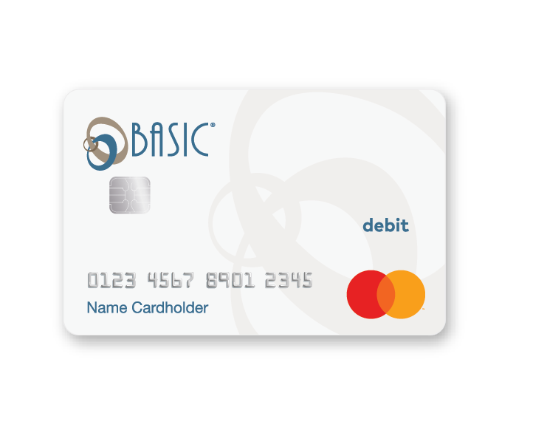
How to Access Your FSA Money

Slide 4
BASIC Card
Smart benefits card with access to all participant benefit accounts and MyCash
Eliminates the need for reimbursement requests
Proprietary technology instantly withdraws funds from the appropriate account(s)

Slide 5
BASIC Card
A Mastercard card will be issued upon enrollment
The BASIC Card comes loaded with the full Medical FSA election, and the up-to-date Dependent Care payroll deductions
Use anywhere Mastercard is accepted

Slide 6
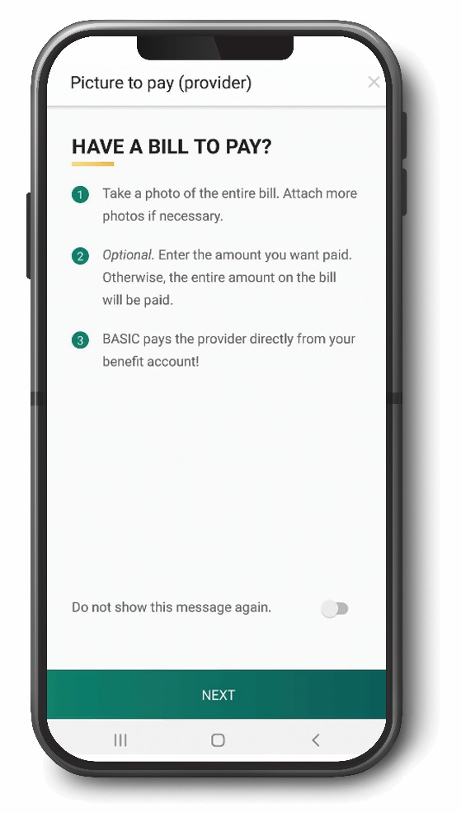
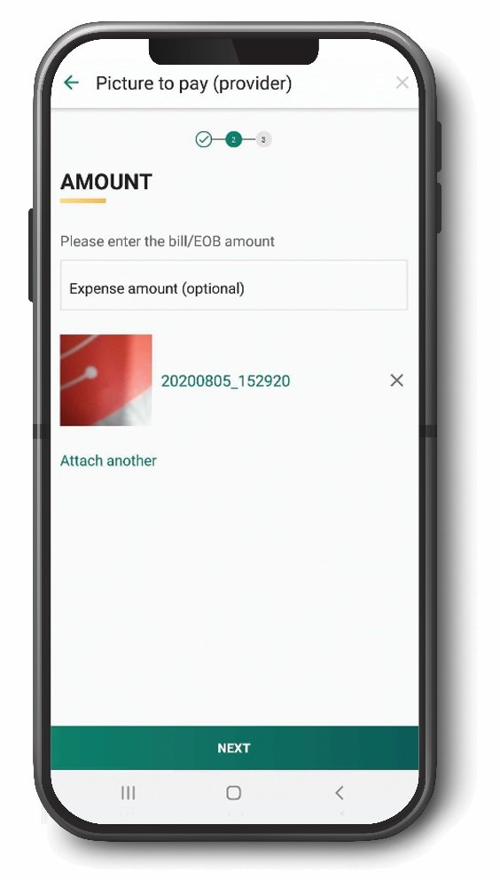
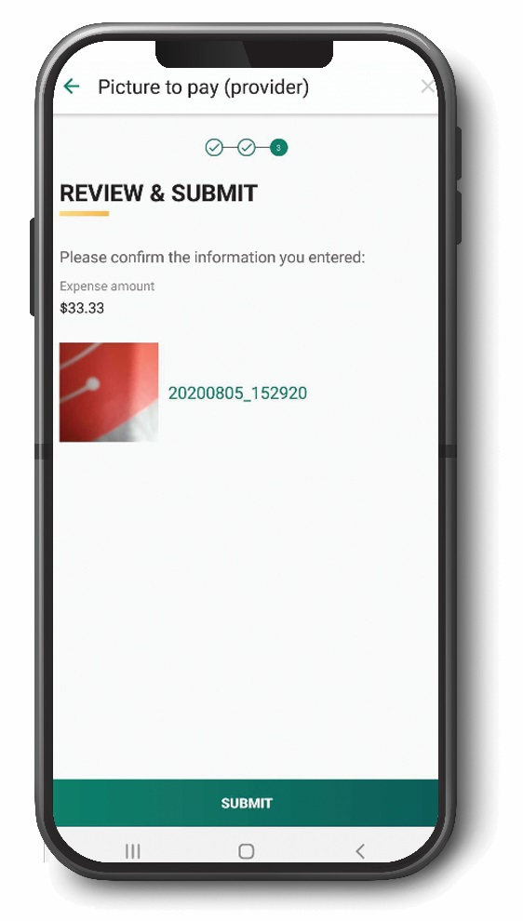
Picture to Pay
Take a picture of an eligible benefit expense/bill, then submit via the BASIC Benefits App
No forms to fill out and no need to sign-in to a website
Just click and submit and we’ll take care of the rest

Slide 7

Manual Reimbursement
Pay the provider out-of-pocket
Submit a claim to BASIC
  BASIC Benefits App submission – Take a photo of your receipt/documentation and upload
  BASIC Consumer Driven Accounts System (cda.basiconline.com) – Upload a scan or photo of your receipt/documentation
A tax-free payment will be deposited into your MyCash Account
  Faster than the speed of bank direct deposit

Slide 8

MyCash
MyCash is an unrestricted post-tax reimbursement account linked to participants’ BASIC Cards.
Reimbursements deposited directly into participants’ MyCash accounts – faster than check or direct deposit!
  Pay for non benefit eligible expenses from the MyCash account by using the BASIC Card anywhere Mastercard is accepted
  Transfer MyCash funds to personal savings or checking account via one-time or recurring transfer
  Withdraw MyCash funds at an ATM

Slide 9
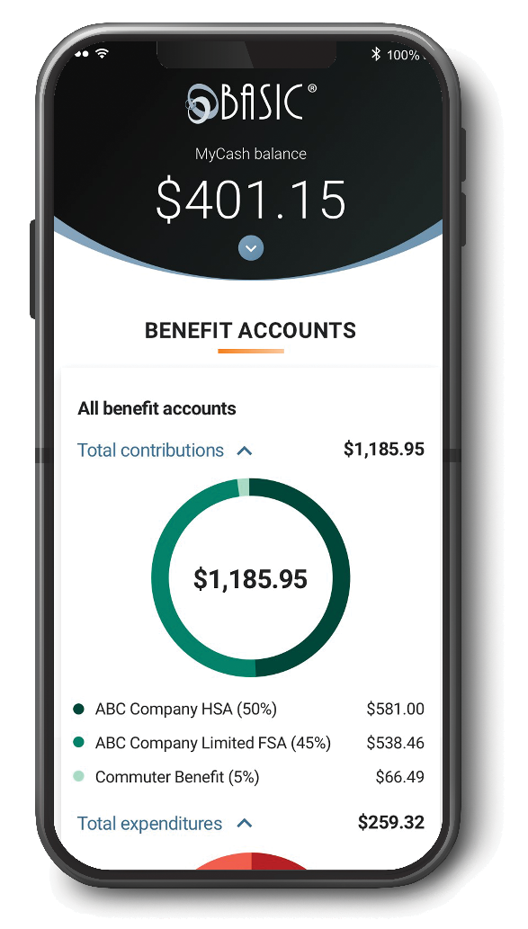


BASIC Benefits App
Participants can track and manage all their BASIC benefit accounts with a
single app – anywhere, anytime!
Access account information
Request reimbursement
Expense eligibility check
Mobile card lock if BASIC card is lost or stolen

Slide 10

Important Card Information
We have a 93% auto substantiation rate for debit card purchases
In some instances, participants will need to submit itemized documentation of their BASIC Card purchases
In all cases, itemized documentation for
transactions should be kept

Slide 11
Medical
Flexible Spending Accounts

Slide 12
What Is an FSA?
A Flexible Spending Arrangement (FSA) is a benefit program that reimburses specified, incurred expenses with pre-tax dollars
  Medical FSAs are governed under §125 of the Code
  Dependent Care FSAs are governed under §129 of the Code
Employee contributions to FSAs must be made through a Section 125 cafeteria plan through their employer

Slide 13
How Does It Work?
Held in an
account for
you
Returned to
you tax-free
for qualified
expenses
Pre-tax Paycheck
Dollars
Employees elect a set amount for medical expenses and a separate amount for dependent care expenses.
Every dollar you put in your FSA plan is Tax Free
You do not pay:
  Federal Taxes
  State Taxes
  (and local taxes if applicable)
  Social Security and Medicare Taxes

Slide 14
How Much Can I Save?
Out-of-Pocket Expenses | Annual Average | Taxes Saved (27% Tax Bracket)
Physician | $940 | $254
Co-Pay | $470 | $127
RX | $660 | $178
Outpatient Hospital | $430 | $116
Medical Total: | $2500 | $675
Dependent Care: | $5000 | $1350
Grand Total: | $7500 | $2025
You could save up to $2,025 per year or more.*
*Depends on Tax Bracket

Slide 15
Eligibility
Employees do not need to be on the employer’s health plan in order to participate in FSA plans
Medical expenses can be incurred by the employee, spouse, employee’s children, who have not attained age 27 as of the end of the taxable year, or the employee’s other “tax dependents”
Expenses must be incurred after the employee was a medical FSA participant
Expenses must be incurred during the plan year

Slide 16
Your FSA Plan
Plan year: 10/1/2023 – 9/30/2024
Maximum medical election: $3,050
Use-it-or-lose-it: Unused contributions remaining at the end of the year will be forfeited by the participant

Slide 17
Your FSA Plan - continued
Medical
  Carryover - allows participants to roll over $610 from one plan year to the next. The $610 is not calculated into the IRS maximum contribution.
  Run Out Period - is the time available following the end of the plan year in which people can submit expense. The last day to incur expenses is 9/30/2024, and the last day to submit expenses is 12/31/2024.

Slide 18
Medical FSA Eligible Expenses
Medical, dental and vision co-pays, deductibles, and coinsurance
Prescriptions (including mail order)
Eyeglasses, Lasik, and contact lenses
Dental expenses including orthodontia
Nursing care and physical therapy
Smoking cessation programs and nicotine patches/gum
Diabetic supplies
Physical impairments
Hearing exam, hearing aids, and special batteries
Expanded eligibility list can be found here:
https://www.basiconline.com/wp-content/uploads/2016/10/Flex-Eligible-List.pdf

Slide 19

FSAs Are More Flexible!
Over-the-counter (OTC) medications and menstrual products are now FSA-eligible with the enactment of the CARES Act in 2020
OTC medicine such as pain relief, allergy pills, cough, cold, flu, and stomach remedies
Menstrual products including tampons, pads, liners, sponges, and cups

Slide 20
Dependent care
Flexible Spending Accounts

Slide 21
Dependent Care Eligible Expenses
Employee and spouse, if any, must be working, looking for work, or a full-time student
Expenses for care of qualifying dependents (i.e., the primary purpose is to ensure the individual’s well-being and protection)
Qualifying dependents are:
  A dependent child who has not attained the age of 13; or
  A spouse or other dependent who is physically or mentally incapable of caring for himself/herself and who has the same principal residence as the participant for more than half the year
Expanded eligibility list can be found here:
https://www.basiconline.com/wp-content/uploads/2020/04/BASIC-Dependent-Care-FSA.pdf

Slide 22
What is Documentation?
Explanation of Benefits (EOBs) are the best form of documentation
  If you don’t receive paper copies in the mail, you can most likely download EOBs from your medical carrier’s website
Receipts must show:
  Date of service (not payment date)
  Type and nature of service
  Who provided the service
  Cost of service
  Patient name
BASIC cannot accept canceled checks, credit card receipts, or balance forward/balance due invoices.

Slide 23
Your Dependent FSA Plan
Plan year: 10/1/2023 – 9/30/2024
Maximum dependent care election: $5,000 if married and filing a joint return, or if the participant is filing single and $2,500 if the participant is married filing separate
Use-it-or-lose-it: Unused contributions remaining at the end of the year will be forfeited by the participant

Slide 24
Your Dependent FSA
Dependent
  Grace Period - up to two and one-half months after the end of the plan year to use funds in an FSA. The last day to incur expenses is 12/15/2024.
  Run Out Period - is the time available following the end of the plan year in which people can submit expense. The last day to submit expenses is 12/31/2024.
  No Carryover

Slide 25

What Do I Need to Know?
Medical FSA
  You must sign up at open enrollment
  You can only change your election in the event of a qualified status change (e.g., marriage, divorce, birth, adoption, or death)
  Full annual election is available day one
Dependent Care FSA
  You must sign up at open enrollment
  You can change your election if your cost or care changes
  Pay-as-you-go account

Slide 26

THANK YOU
Additional CDA Participant Resources
https://www.basiconline.com/hq/employee/basic_cda/

Slide 27

Contact BASIC FSA
BASIC wants to help you with your benefits!
Please contact BASIC at the phone number below or your HR Department with any questions about your FSA benefit. You can also submit a Support Request via CDA online or in the BASIC benefits app.
  Phone: (800) 372-3539

