Slide 1
Important Information for Parents
1
Notes:
The choices our athletes make about how much sleep they get, what they eat and if they use caffeine, alcohol, marijuana, and other drugs has an impact on athletic performance and their performance in school. It can mean the difference between success in athletics and in life. This is the message we are attempting to send to our student athletes.

Slide 2
Adapted, with permission, from Life of an Athlete New Hampshire/John Underwood
Life of an Athlete Chippewa Valley Schools is a Partnership between Chippewa Valley Schools’ Athletic Departments and the Chippewa Valley Coalition for Youth & Families
Life of an Athlete Chippewa Valley Schools is intended to promote athletic excellence and to foster leaders among our athletes.
2
Notes:
The Chippewa Valley Coalition for Youth and Families joins School, Family, and Community in preventing and reducing youth substance use and preventing youth suicide.
Funds for the development of Life of An Athlete Chippewa Valley Schools were provided by Drug Free Communities grant funds awarded to the Coalition.

Slide 3
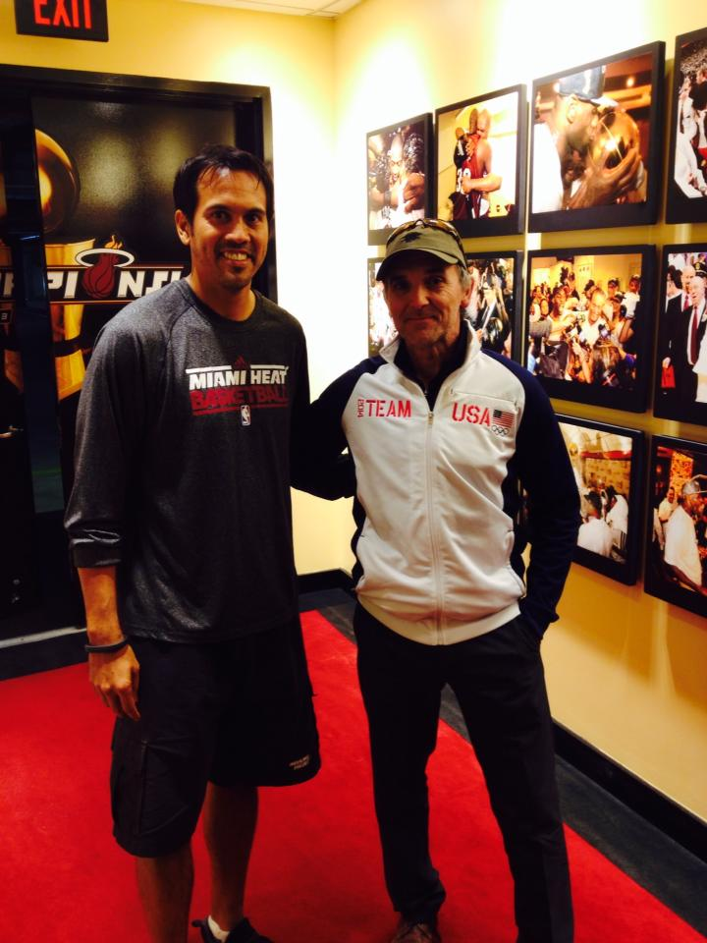
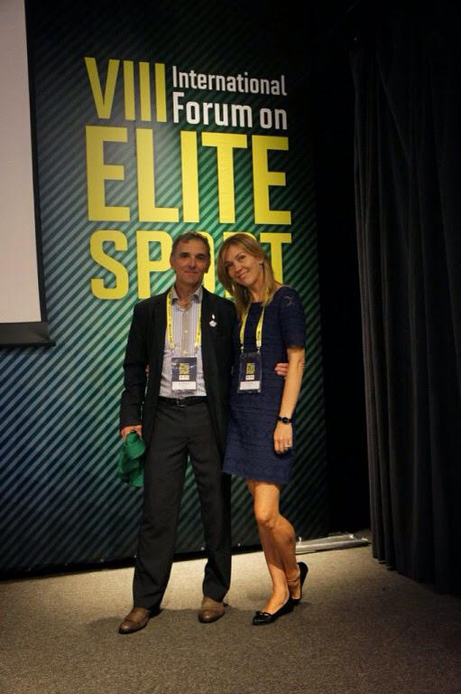
John Underwood Life of an Athlete
FPO
3
Notes:
John Underwood is an Olympic trainer and coach. He has worked with high school and professional athletes, including the National Federation of High School Athletics, NCAA, NHL, NFL and the NBA. He has worked for three decades with the USOC, Sport Canada and the International Olympic Committee. John Underwood is Human Performance Consultant for U.S. Navy SEALS. John’s innovative program “Life of an Athlete”, has gained international prominence and has been implemented in hundreds of schools throughout the country and abroad. John has studied Human Performance at the Sport Institute of Finland/ Vierumaki/ and Lake Placid. He holds three International Olympic Solidarity diplomas for coaching and has been a crusader for drug-free sport at all levels. John is an internationally recognized human performance expert, specializing in recovery, peaking training and lifestyle impact on mental and physical performance.

Slide 4
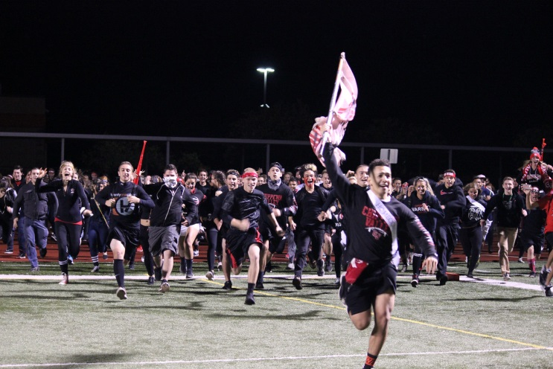
Lifestyle Choices
Why are lifestyle choices important?
Without making healthy decisions, athletic performance can suffer. It can be the difference between: WINNING & LOSING
CHAMPIONS & COMPETITORS
In Athletics and in Life
4
Notes:
The choices an athlete makes about how much sleep they get, how they eat, and if they use caffeine, alcohol and other drugs has a direct impact on athletic performance.
It can mean the difference between winning and losing. This is the message we are trying to send our student athletes.

Slide 5
Impact on Athletic Performance
Sleep
8-10 Hours of sleep per night
6-7 REM Cycles per night
The body replace cells all the time, but not brain cells
In order to repair brains cells, you must shut the system down (spinal fluid flush out toxins, cells distance is greater during sleep)
If an athlete doesn’t receive this amount of sleep:
Split second decision making decreases
Blood Flow is reduced
5
Notes:
Good Health is Comprised of 3 Things: Diet, Exercise, and Sleep.
Rest and recuperation allows the body to reenergize and rejuvenate for next the next day. Its vital to get a good night sleep to perform at an athlete’s best.
The REM cycle is the dream state, think about it as re-booting the brain. To complete this properly, someone needs 6-7 REM cycles, which happen over 8-10 hours
Red/orange light tells the pineal gland to start shutting down to go to sleep. (Think gathering around the warm glow of a fire at night.)
Blue light (that from a TV, Phone, Computer) tells the pineal gland to start revving up. (Think bright blue skies in the morning.)
In addition, the use of alcohol, marijuana, and other drugs, and prescription drug abuse has very negative consequences for athletic performance.

Slide 6
Impact on Athletic Performance
Likelihood of Injury Based on Hours of Sleep per Night
Y=12.6x+87.6 R^2=0.727
Likelihood of Injury Over 21 Months
Average Sleep Per Night (Hrs.)
6
Notes:
Here you can see that the more sleep an athlete gets the less likely he/she is to have an injury.
Making an extra effort to get to bed at a reasonable time can make all the difference in performance.
Student athletes often have rigorous schedules, so staying on top of school work and athletics helps provide a better sleep schedule.

Slide 7
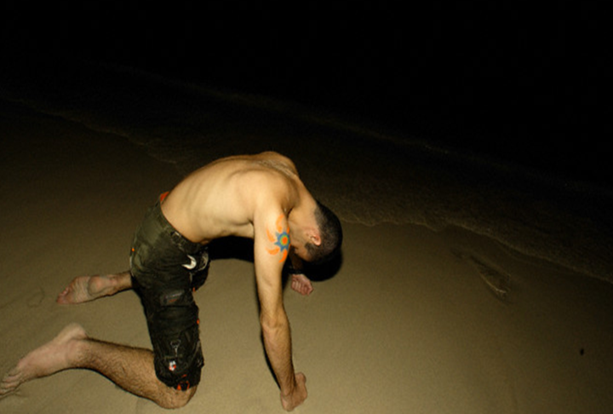
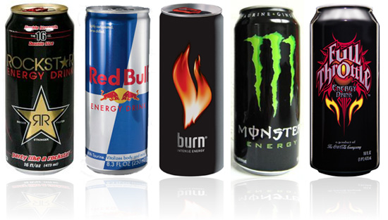
Impact on Your Athletic Performance
Effects of Energy Drinks and Overstimulation
Our Central Nervous System (CNS) can be at a maximal intensity level for only 2-3 hours.
Overstimulation causes the CNS to break down and eventually you get chronically tired.
Overstimulation doesn’t increase physical performance. It limits the ability to maintain a high level of mental & physical performance.
Drinking Red Bull, Monster, Rockstar, Mountain Dew Amp, NOS, Tilt, etc. can create overstimulation.
FPO
7
Notes:
Even if an athlete is making the right lifestyle decisions, he/she can only perform at his/her physical peak for 2-3 hours.
After that, muscles become fatigued and need rest.
Athletes often use energy drinks.
Energy drinks can cause overstimulation and, over time, they have more difficulty getting to where they want and need to be.
The sugar and caffeine rush only lasts 15-20 minutes and after that the mind and body crashes.

Slide 8
Impact on Athletic Performance
How to fuel the body:
Keep blood sugar UP
The body runs on GLUCOSE
Whole Grain Pasta
Fruits
Vegetables
The body DOES NOT run on SWEETS
Cake
Candy
Cookies
FPO
8
Notes:
The Life of an Athlete Power Back diet provides the proper nutrition for an athlete.
An electronic version can be found on our Chippewa Valley Life of an Athletic website.
The best way to keep the blood sugar up is to eat whole grains, fruits and vegetables.
Cookies and cakes are digested as sugar and leave an athlete feeling depleted.
Athletes need to plan ahead with snacks so they feel full longer.

Slide 9
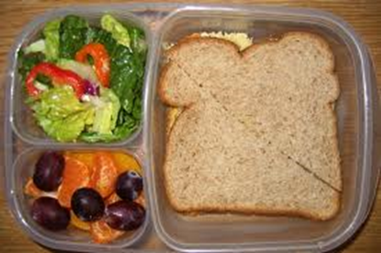
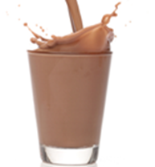
Impact on Athletic Performance
Phase 1: Before Competition or Training:
EAT: A carbohydrate-rich meal or snack 2-4 hours before exercise:
½ Turkey Sandwich, Small Salad
String Cheese, Crackers and an Apple
Cereal, Banana and Peanut Butter
DRINK:
A small amount of fast-digesting protein (4-6 oz.)
FPO
9
Notes:
Having a carbohydrate-rich snack is important to keeping the body’s “engine” going.
Without it, athletes can feel sluggish and slow with nothing to burn.

Slide 10
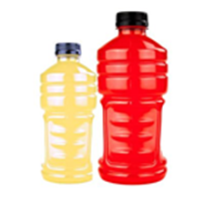
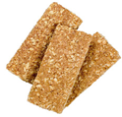
Impact on Athletic Performance
Phase 2: During Competition or Training:
DRINK: Hydrate with 10+ oz. of a sports drink & water mixed together
EAT: Healthy snacks to maintain blood sugar levels
FPO
10
Notes:
Staying hydrated is another essential part of “keeping the engine going”. A good way to get the electrolytes and decrease the sugar is to pour out half a sports drink and add half water.
Eating healthy snacks throughout the day keeps the blood sugars level.
Think about the snacks that will hold up well in a gym bag.

Slide 11
Impact on Athletic Performance
Phase 3: Right after Competition or Training:
Step 1 (Directly after): -Drink 4-6 oz of Gatorade/Powerade & Water mix Step 2 (10-30 minutes after): -Drink 12-16 oz of Whey Protein or 20-30 oz of Low-Fat Chocolate Milk -Eat 75g Carbohydrates(2 Handfuls of raisins or 2-3 fig bars) Step 3 (1 hour): -Eat full meal containing approximately: ½ fruits or vegetables ¼ protein ¼ carb
RECOVERY TIME
Hour 1 | 70%
Hours 2-8 | 20%
Hours 9-24 | 10%
11
Notes:
These are some suggestions for after training.
Liquid protein (such as low fat chocolate milk, whey protein or yogurt) is the quickest way to replenish the body and give muscles the proper nutrients to recovery for the next day.
70% of recovery happens in the first hour, making it critically important that the proper nutrition happens right away.

Slide 12
Reading Labels
Nutrition labels can be deceiving
1. Pay attention to the serving size
2. Limit the amount of total fat, sugar, and sodium.
3. Get enough of the suggested nutrients such as protein, fiber, and vitamins.
4. Ingredients have hidden names for sugar most end in “cose”.
Example:
Sucralose
Glucose
Sucrose
Cane fructose
12
Notes:
Nutrition labels can be deceiving. Pay attention to the serving size. The number of servings in a food package is essential to note.
Athletes need a balance of nutrients, protein, fiber and vitamins.
Eating the suggested amount of total fat, sugar, cholesterol and sodium is important for a healthy diet
Be aware that ingredients often have hidden names for sugar. Hidden sugars tend to end in “cose.”

Slide 13
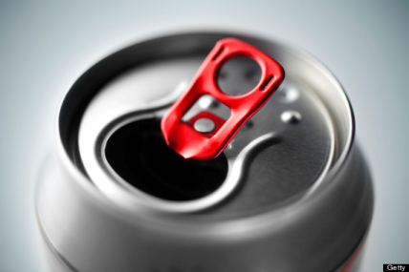
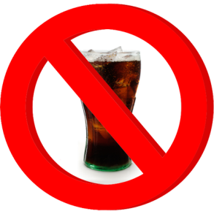
Impact on Athletic Performance SODA
Soda and sugary beverages have no nutritional value and are loaded with sugar.
These beverages are known to have many negative effects on the body, including heart diseases, diabetes, and weight gain.
Soda weakens enamel, which over time leads to bacterial plaque that causes cavities.
Even diet soda contains artificial sweeteners which can increase your cravings for sweets and junk foods.
FPO
13
Notes:
Soda is loaded with sugar in the form of high fructose corn syrup (HFCS).
HFCS is known to have many adverse effects on the body, including elevated blood cholesterol and phosphorus levels, increased risk of heart diseases and diabetes, weight gain and morbid obesity, etc.
Each time soda is sipped, sugar bonds with bacteria in the mouth, giving rise to acid. This acid weakens enamel in teeth, which, over time, leads to bacterial plaque that causes cavities.

Slide 14
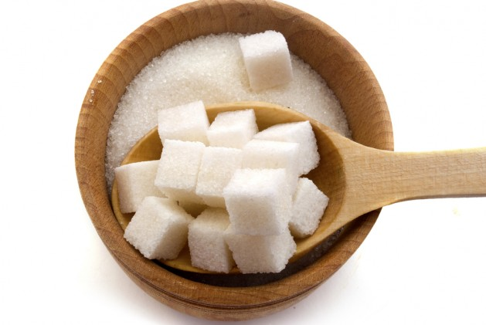
Impact on Athletic Performance SUGAR
Natural Sugar
Fructose natural sugar found in:
fruits and honey
Glucose natural “simple” sugar in starches, such as:
potatoes and pasta
High Fructose Corn Syrup
HFCS is made from corn starch that is processed to glucose that turns into fructose.
Links have been made with HFCS to obesity and heart disease.
“Artificial Sweeteners”
Artificial sweeteners are synthetic sugar substitutes.
Some sugar substitutes are natural and some are synthetic. Those that are not natural are called artificial sweeteners.
Significant amounts of artificial sweeteners can be decrease performance.
14
Notes:
It is important to pay attention to the types of sugars in the foods your athlete is eating.
Natural sugars in moderation are fine, but significant amounts of artificial sweeteners are detrimental to performance.

Slide 15
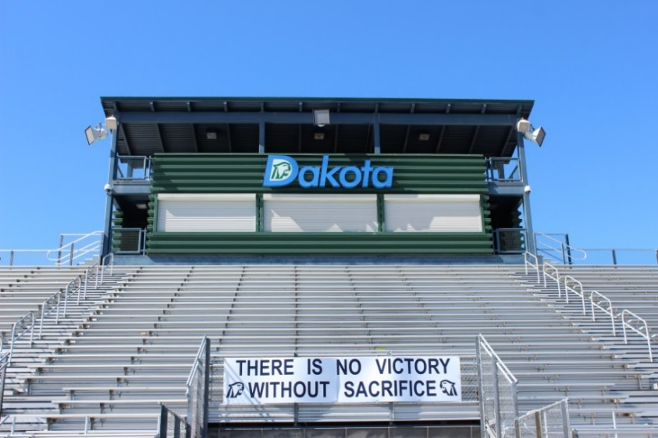
Impact on Athletic Performance
Alcohol, Marijuana, Tobacco, and Other Drugs
Interfere with an athlete’s physical and mental ability.
Strength/Speed is reduced
Training-Recovery-Adaptation effect is impeded
Lung Capacity is diminished
Reaction time is slowed
Neuromuscular connection is impacted
Performance time is decreased
Thought processes are reduced
FPO
15
Notes:
Let your athlete know that Alcohol, Tobacco, Marijuana and other Drugs have negative consequences for any athletic performance (and can lead to addiction).

Slide 16
Alcohol, Marijuana, Tobacco, and Other Drug Use and the Teen Brain
16
Notes:
Tell your athlete that their brains are a “work in progress” and don’t stop developing until their mid-20s.
Tell them that teens become addicted to any substance (alcohol, marijuana, or tobacco, etc.) more quickly than adults because their brains are developing.
(Contrary to what many people believe, we have learned from research that marijuana IS an addictive drug. https://teens.drugabuse.gov/)
Tell them that the use of alcohol, marijuana, or other drugs can cause irreversible damage to the developing brain.

Slide 17
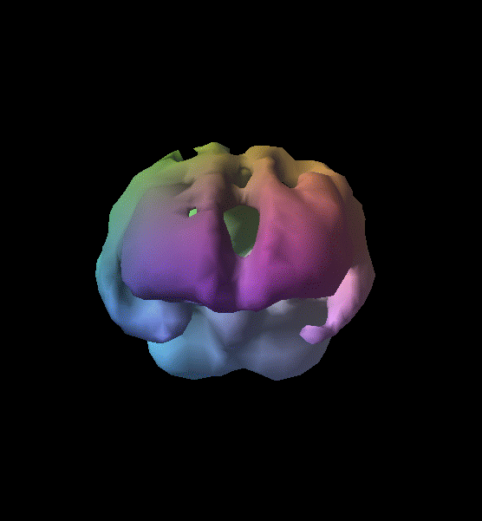
Brain Activity of a Teen Alcohol User
Healthy Teenager
Alcohol User
17
Notes:
These are brain scans of the healthy teenager and that of a teen that uses alcohol regularly.
The areas missing in the scan on the right aren’t holes. They show areas of decreased blood flow and, therefore, decreased brain activity.
This means the brain signals need to find another path within the brain to respond.
The teen on the right is far less likely to perform well athletically and in school.

Slide 18
Impact on Athletic Performance - Alcohol
High School Athletes lose between 15% to 30% from their overall performance when they drink alcohol.
ONE NIGHT of binge drinking ELMINATES the impact of 2 WEEKS of training and play.
Athletes who drink regularly are 2 times more likely to be injured as non-drinkers. There is a:
54% injury rate for drinkers and
24% injury rate for non-drinks.
18
Notes:
Athletes that drink alcohol are not only at risk for injury.
Use of alcohol decreases an athletes ability to perform.
One night of binge drinking can negatively effect 2 weeks of training and play.

Slide 19
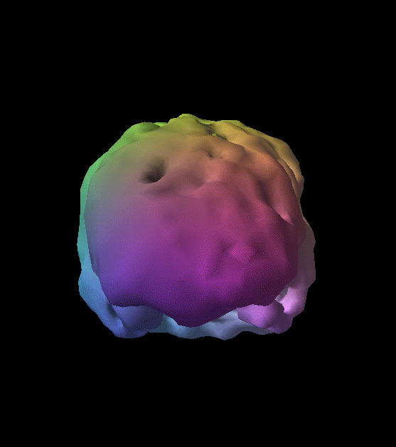
Brain Activity of a Teen Marijuana User
Healthy Teenager
Marijuana User
19
Notes:
These are scans of a healthy teenager’s brain and that of a regular marijuana user.
There is much less activity in the brain of the marijuana user.
This means that the ability to think, react, store memory, and learn is negatively affected.
Use of marijuana can significantly affect performance many days after use.

Slide 20
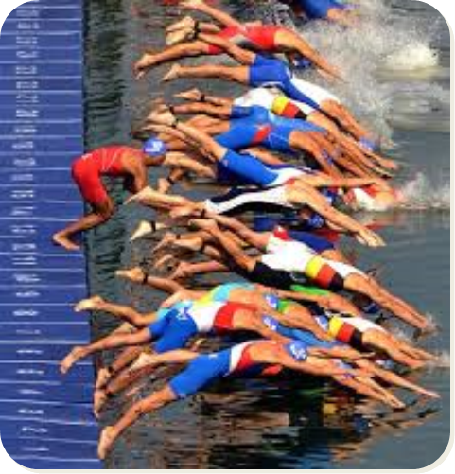
Impact on Athletic Performance - Marijuana
Contains 4x the amount of tar found in Tobacco smoke
Contains 50-70% more cancer-producing chemicals than tobacco
FPO
Response time to visual stimulus
Condition | Msec/Response
Well Rested | .186
Without Sleep | .246
Marijuana User | .300 -.450
20
Notes:
Marijuana contains 4x the amount of tar found in Tobacco smoke and 50-70% more carcinogens (chemicals that cause cancer).
Considerable research shows that marijuana use affects response time, attention, memory, and is addictive, especially for teens. (ncadd.org 2015)
There is much misinformation about marijuana.
Marijuana is particularly unsafe for teens and young adults, whose brains are developing.

Slide 21
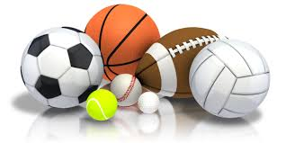
Impact on Athletic Performance - Marijuana
Marijuana use negatively affects timing, movement, reflexes, ability to track, coordination, concentration, memory, and judgement all of which harms athletic performance. NIDA, 2014
21
Notes:
Marijuana has no performance-enhancing potential.
Marijuana: Facts for Teens January 2014 NIDA - https://teens.drugabuse.gov/drug-facts/marijuana provides important research-based information about marijuana.
(NIDA, the National Institute on Drug Abuse, is a United States federal-government research institute whose mission is to "lead the Nation in bringing the power of science to bear on drug abuse and addiction.“)

Slide 22
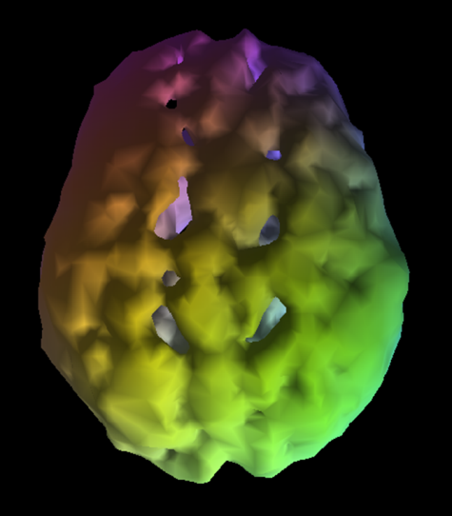
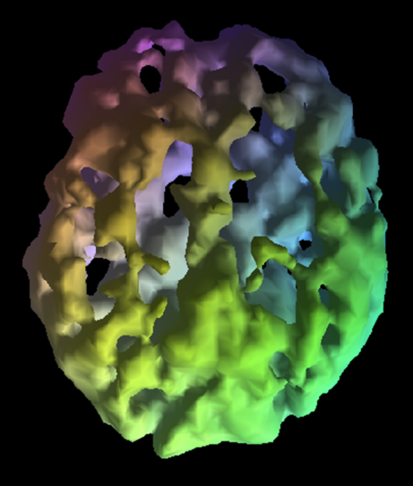
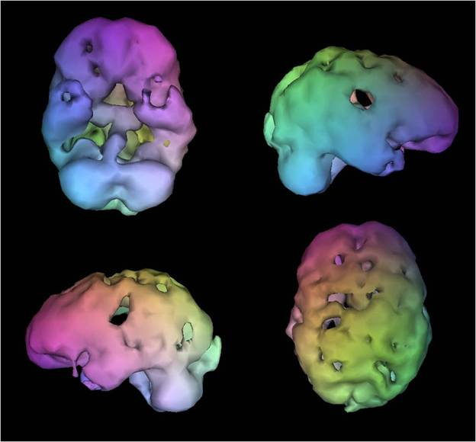
Brain Activity – The Results of Using Other Drugs
Cocaine User
Meth User
Heroin User
22
Notes:
Use of these substances dramatically affects brain chemistry and has negative affects on all areas of development.

Slide 23
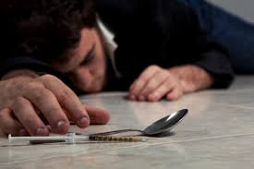
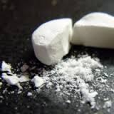
Impact on Your Athletic Performance
Abuse of Prescription Pain Killers (Opioids)
Vicodin, Percocet, OxyContin, etc.
Use only as prescribed by a medical professional
Stop as soon as possible
Signs of Addiction to Opioid Pain Killers
Physical and Emotional Changes:
Clammy skin, tiny pupils, skin rashes, nausea and vomiting, difficulty breathing, sleepiness, confusion, low energy levels, seizures, low blood pressure, coma
Depression, aggravation, violence, other personality changes
Prescription Drug Abuse Can Lead to Heroin Use/Addiction.
FPO
23
“Sports Injury Leading to Oxycodone Addiction”. Oxycodone Addiction Help. October 30, 2014. http://www.oxycodoneaddictionhelp.com/sports-injury-leading-to-oxycodone-addiction
Notes:
Athletes may be at higher risk of developing an addiction to pain medication, e.g. Vicodin, Percocet, OxyContin, etc. because of sports injuries for which opioid painkilling medication may be prescribed.
We need to be very aware of the dangerous potential for pain medication prescribed for an injury to end in addiction.
Athletes taking prescriptions for treating pain should stop use as soon as soon as possible.
Abuse of Prescription Painkillers can lead to Heroin use/addiction.

Slide 24
The Role of Parents
SUPPORT YOUR ATHLETE!
Parenting Do’s:
Cheer everybody on the team, not just your child
Model appropriate behavior
Encourage your child to talk to the coach first
Be a good listener and great encourager
TALK WITH YOUR ATHLETE ABOUT THE DANGERS OF ALCOHOL, MARIJUANA, AND OTHER DRUGS AND OF PRESCRIPTION DRUG ABUSE.
Parenting Don’ts:
Overemphasizes sports at the expense of sportsmanship
Have different goals than your child
Treat your child differently after a loss
Undermine the coach
Live your dream through your child
FPO
Henson, Steve. “What Makes A Nightmare Sports Parent- And What Makes A Good One.” The Post Game. 2.15.12. http://www.thepostgame.com/blog/more-family-fun/201202/what-makes-nightmare-sports-parent. 9.24.14.
24
Notes:
We look forward to the season/year and working together to support your students. We wanted to outline the behaviors we know everyone in this room is ready and willing to follow to ensure a great season/year.

Slide 25
Chippewa Valley Schools
ATHLETIC CODE OF CONDUCT
We Support Good Sportsmanship and Educational Athletics
Our Athletes are EXPECTED to be
RESPECTFUL and RESPONSIBLE!
To cheer positively for their team
Not to taunt or display disruptive behavior
To accept officials’ decisions
25
Notes:
By participating on a school team, your athlete is voluntarily agreeing to accept and follow the rules, requirements, standards, and regulations in the Athletic Code of Conduct, as well as any rules, requirements, standards, and regulations of your team.
Being on a team is a privilege, not a right.
The Athletic Code of Conduct provides the Athletic Mission Statement for Chippewa Valley Schools, as well as Athletic Program Beliefs, Eligibility, Rules, and Transportation Policy,
All athletes and their parents are expected to read and to be familiar with the Athletic Code of Conduct.
Any questions should be directed to your Coach or the Athletic Director.

Slide 26
Chippewa Valley Schools
Athletic Code of Conduct
ADDICTIVE AND ILLEGAL SUBSTANCES
AND OTHER MISCONDUCT
Addictive substances – the use, possession, distribution or sale of addictive and illegal substances by student athletes is prohibited.
Other Misconduct: Any conduct that dishonors the athlete, the team and the school will not be tolerated. For any acts of unacceptable conduct such as , but not limited to, theft, extortion, vandalism, assault, sexual misconduct, gross disrespect, hazing, or inappropriate use of the internet, electronic devices or communication systems.
26
Notes:
An important part of the Chippewa Valley Schools Athletic Code of Conduct is that which addresses the use, possession, and/or distribution of alcohol, marijuana, or other drugs, as well as the abuse of prescription medications and/or sharing of medications prescribed to someone else.

Slide 27
ATHLETIC CODE OF CONDUCT
Consequences of Use of
Addictive and Illegal Substances:
First Offense – Lose 25% of competitions, plus taking the online Life of an Athlete course. Certification of completion is required.*
Second Offense – Lose 50% of competitions, plus professional consultation selected by the school district and paid for by the athlete. Verification from the professional agency is required following completion of the consultation.
Third Offense – Suspension from all competitions for the remainder of middle school or high school career.
*An athlete’s first tobacco violation – Lose 10% of competitions.
For any further tobacco violation, the above consequences will apply.
27
Notes:
Read through the Consequences.

Slide 28
Important Information
Athletes MUST take the Life of an Athlete Survey
BEFORE They Can Play on a Team for Their School
The survey must be taken the FIRST TIME a sport is played during a school year. Athletes don’t need to take the survey again if they play other sports during
the school year.
The Life of an Athlete Survey is accessed via a computer
at
http://cvsloa.org/LOASurvey
Dan Serard Program Coordinator, Life of an Athlete
Notes:
Athletes MUST take the Life of an Athlete Survey before they can play on a team for their school.
The Survey must be taken the first time an athlete plays a sport during the school year.
Athletes don’t need to take the survey again if they play other sports during the school year.
The survey is accessed vie computer and cannot access the survey via a phone.

Slide 29
Important Information
Visit:
Chippewa Valley Schools Life of an Athlete Website
http://cvsloa.org/
Parent Resources
Leadership Guide
Power Back Diet
Sleep and Recovery
Code of Conduct
And More!
Questions? Talk With Your Coach or Athletic Director
Dan Serard Program Coordinator, Life of an Athlete
Notes:
Visit our Life of an Athlete website to get additional information that is important for parents and athletes.

